Slide 1
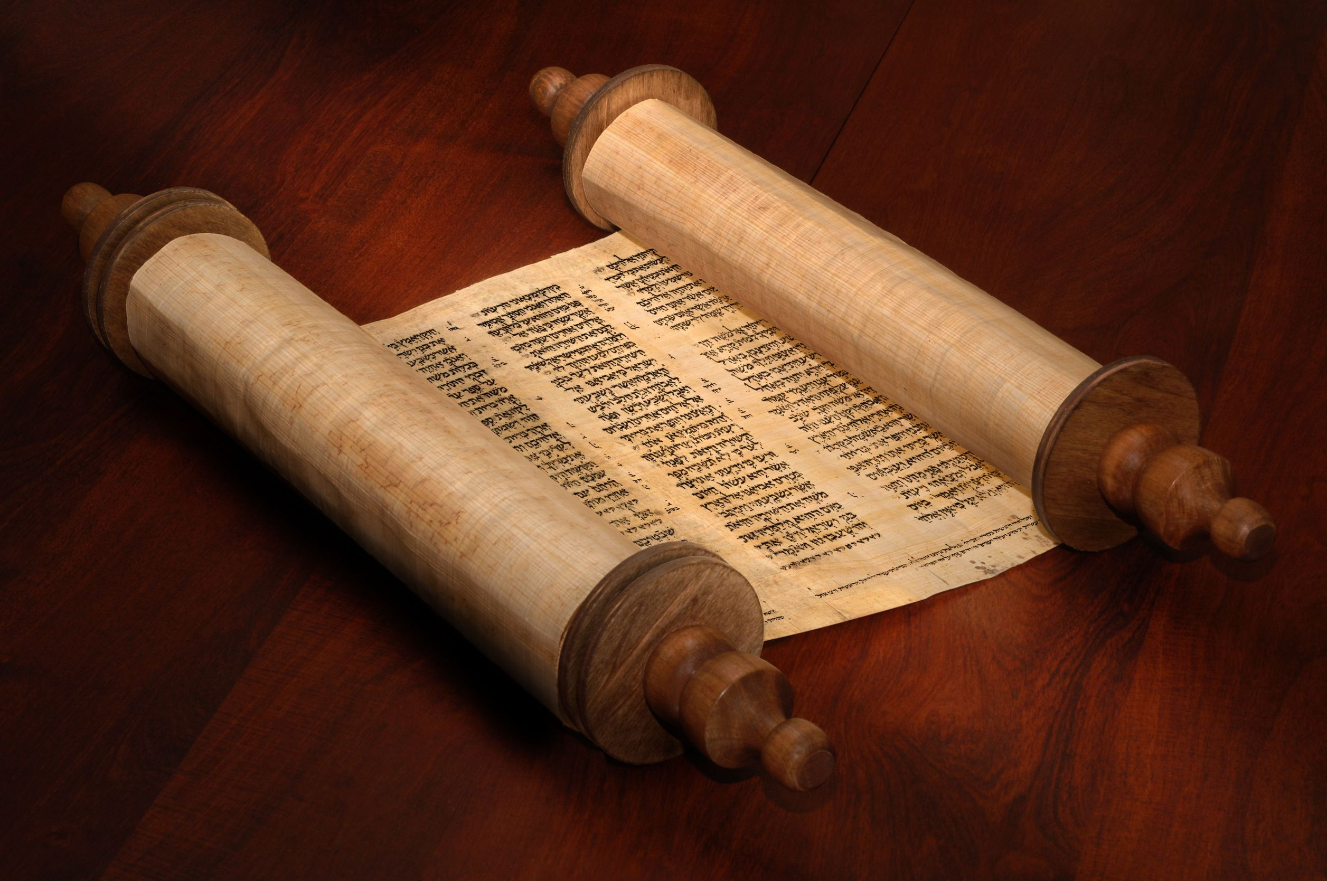
God’s
Appointments
with YOU

Slide 2
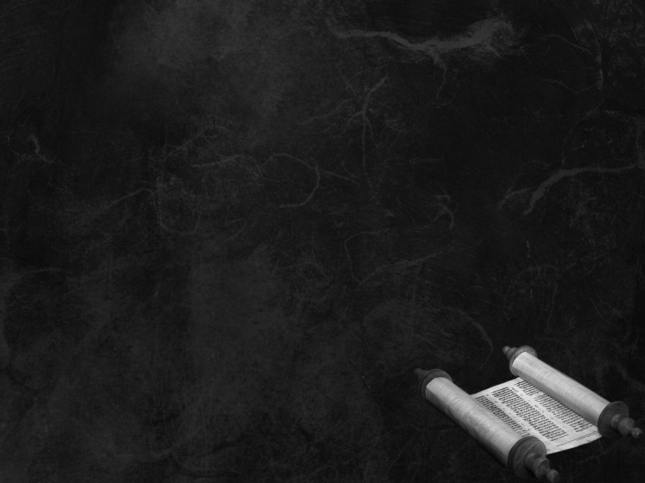
Thriving in Ministry
Thriving in Life
A Journey into an Intimate
Relationship with God
LEARN the Text
LIVE the Text
DIE the Text

Slide 3
The Old Testament
and it’s relevance to believers
TODAY
Israel =
“struggle with God”
“Struggling” with Scriptures
Beginning the Journey
to Intimacy

Slide 4
A possible outline…
The Appointed Times
Old & New Covenants
The Sabbath Day
Struggling With Scriptures

Slide 5
God’s
Appointments
with YOU
Leviticus 23

Slide 6
Leviticus 23:1–2
The LORD spoke to Moses, saying, “Speak to the people of Israel and say to them, These are the appointed feasts of the LORD that you shall proclaim as holy convocations; they are my appointed feasts.”.
The LORD = YHWH
“Yahweh” ?
“Yahuah” ?

Slide 7
Exodus 3:15
Say this to the people of Israel, “YHWH, the God of your fathers, the God of Abraham, the God of Isaac, and the God of Jacob, has sent me to you.” This is my name forever, and thus I am to be remembered throughout all generations.

Slide 8
Leviticus 23:1–2
YHWH spoke to Moses, saying, “Speak to the people of Israel and say to them, These are the appointed feasts of YHWH that you shall proclaim as holy convocations; they are my appointed feasts.”.
appointed feasts = mo’edim
“set times”
“appointed times”
“appointment”

Slide 9
Leviticus 23:1–2
YHWH spoke to Moses, saying, “Speak to the people of Israel and say to them, These are the appointed feasts of YHWH that you shall proclaim as holy convocations; they are my appointed feasts.”.
convocation = assembly, gathering
holy = set apart

Slide 10
Leviticus 23:3
Six days shall work be done, but on the seventh day is a Sabbath of solemn rest, a holy convocation. You shall do no work. It is a Sabbath to YHWH in all your dwelling places.

Slide 11
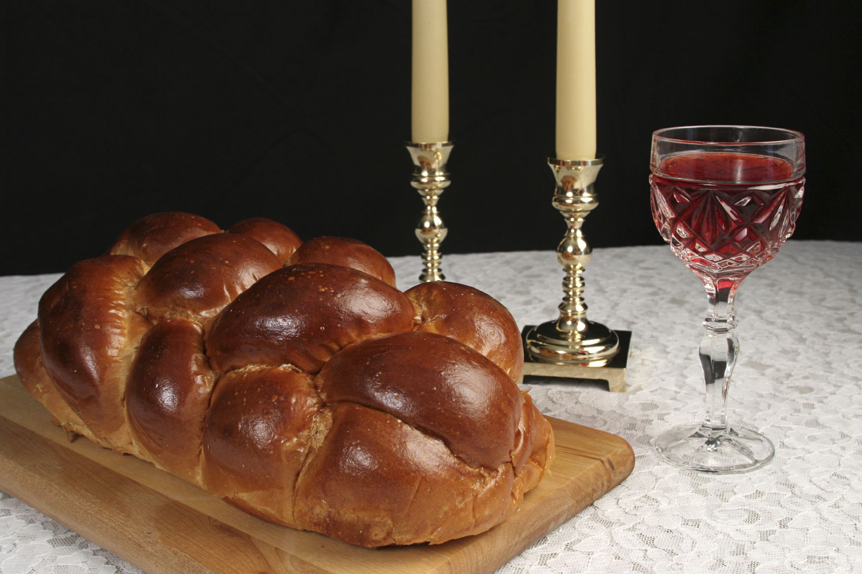
Sabbath

Slide 12
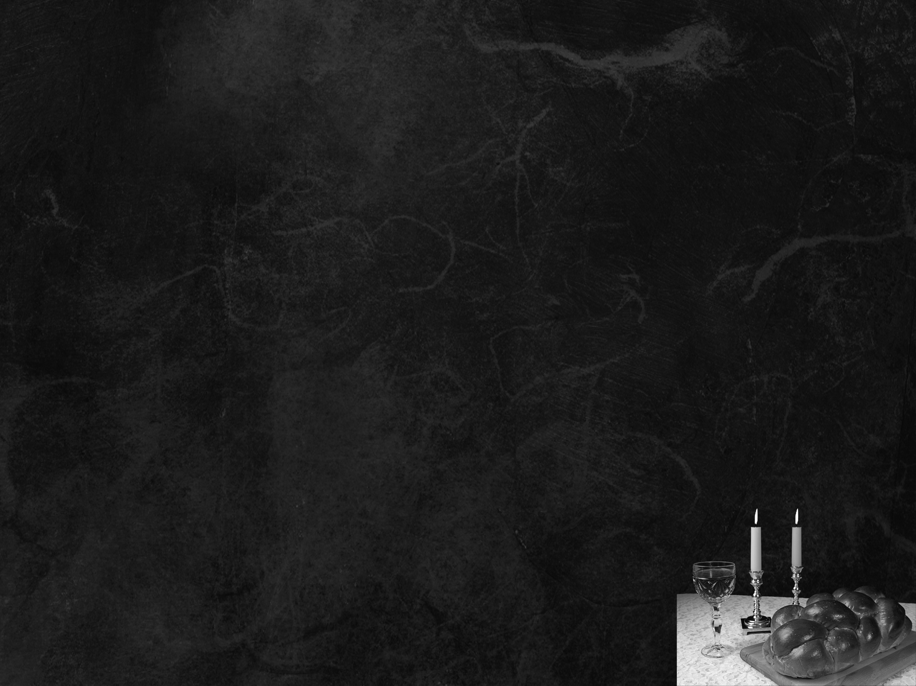
Genesis 2:2-3
And on the seventh day God finished his work that he had done, and he rested on the seventh day from all his work that he had done. So God blessed the seventh day and made it holy.

Slide 13
Appointed Times of YHWH
1 weekly appointment
(the Sabbath)
7 annual appointments

Slide 14
Appointed Times of YHWH
Recall PAST events
Have PRESENT applications
Foreshadow FUTURE fulfillments
Related to Yeshua

Slide 15
New Testament:
English Greek Hebrew
Jesus Iesous Yeshua
Old Testament:
English Greek Hebrew
Joshua Iesous Yehoshua
or Yeshua

Slide 16
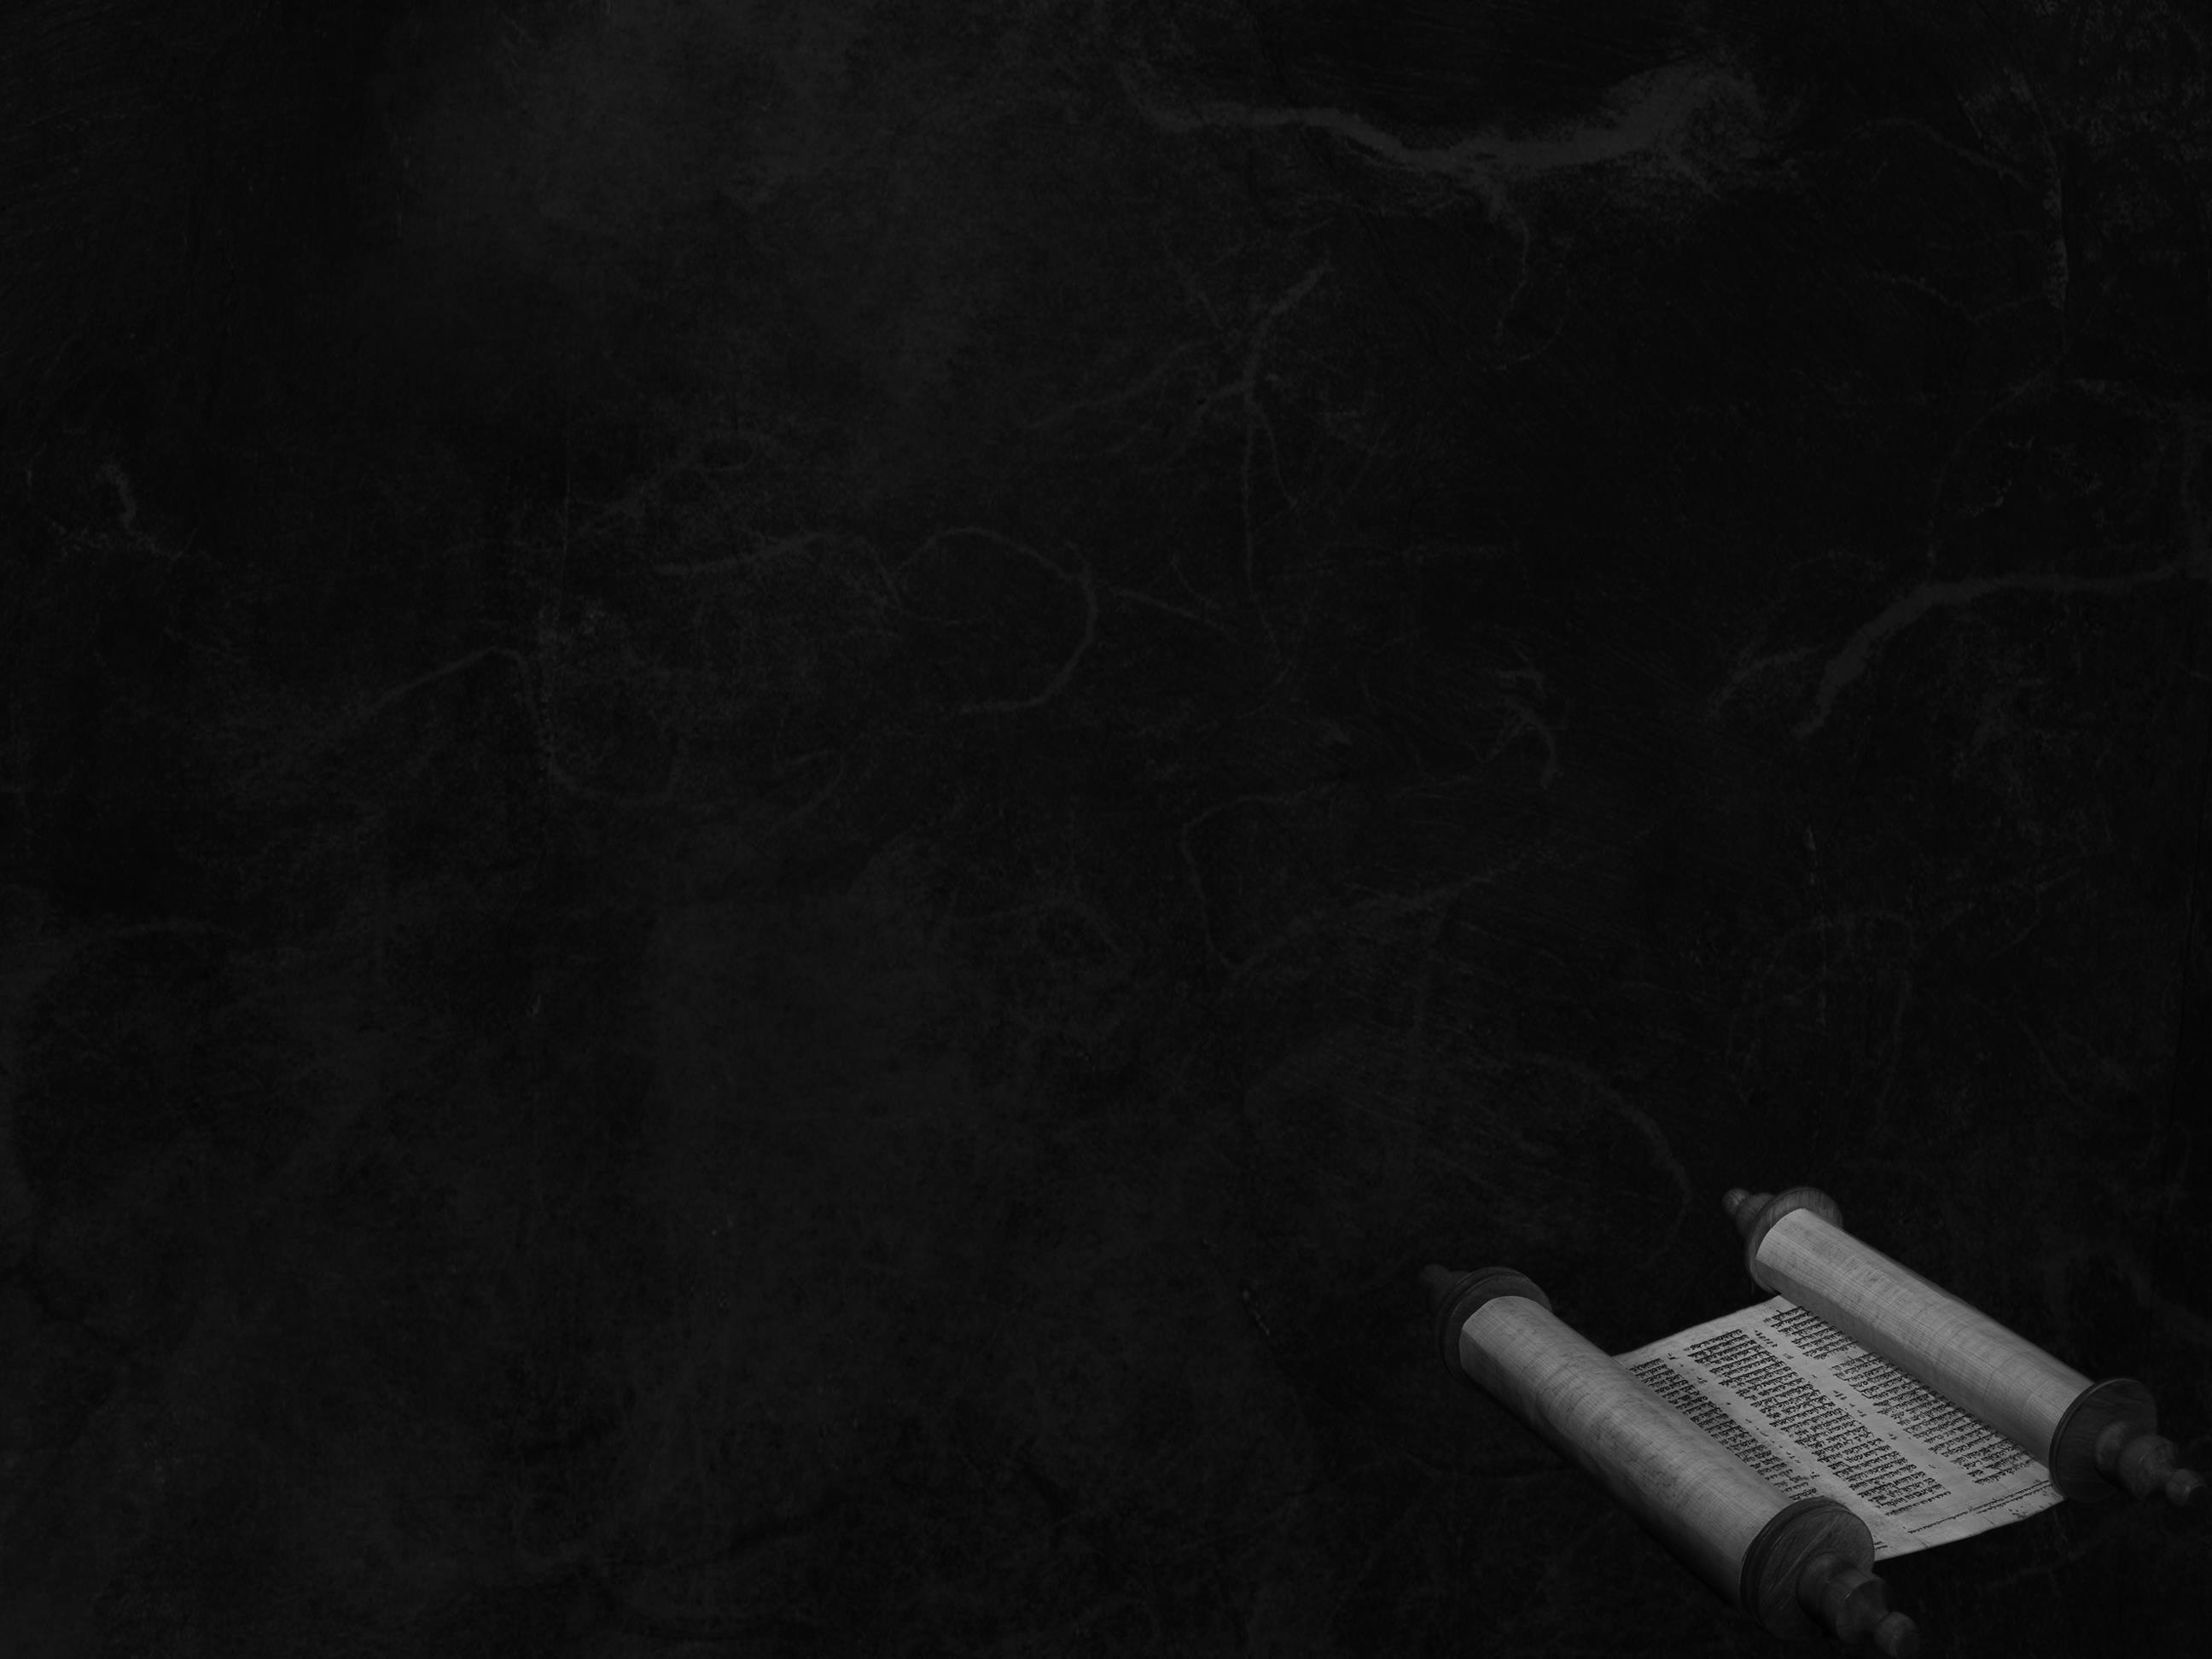
3 Spring Appointed Times
Passover
Unleavened Bread
Firstfruits
Barley
Harvest
Wheat
Harvest
Shavuot (Weeks)
3 Fall Appointed Times
Trumpets
Atonement
Sukkot
Final
Harvest

Slide 17
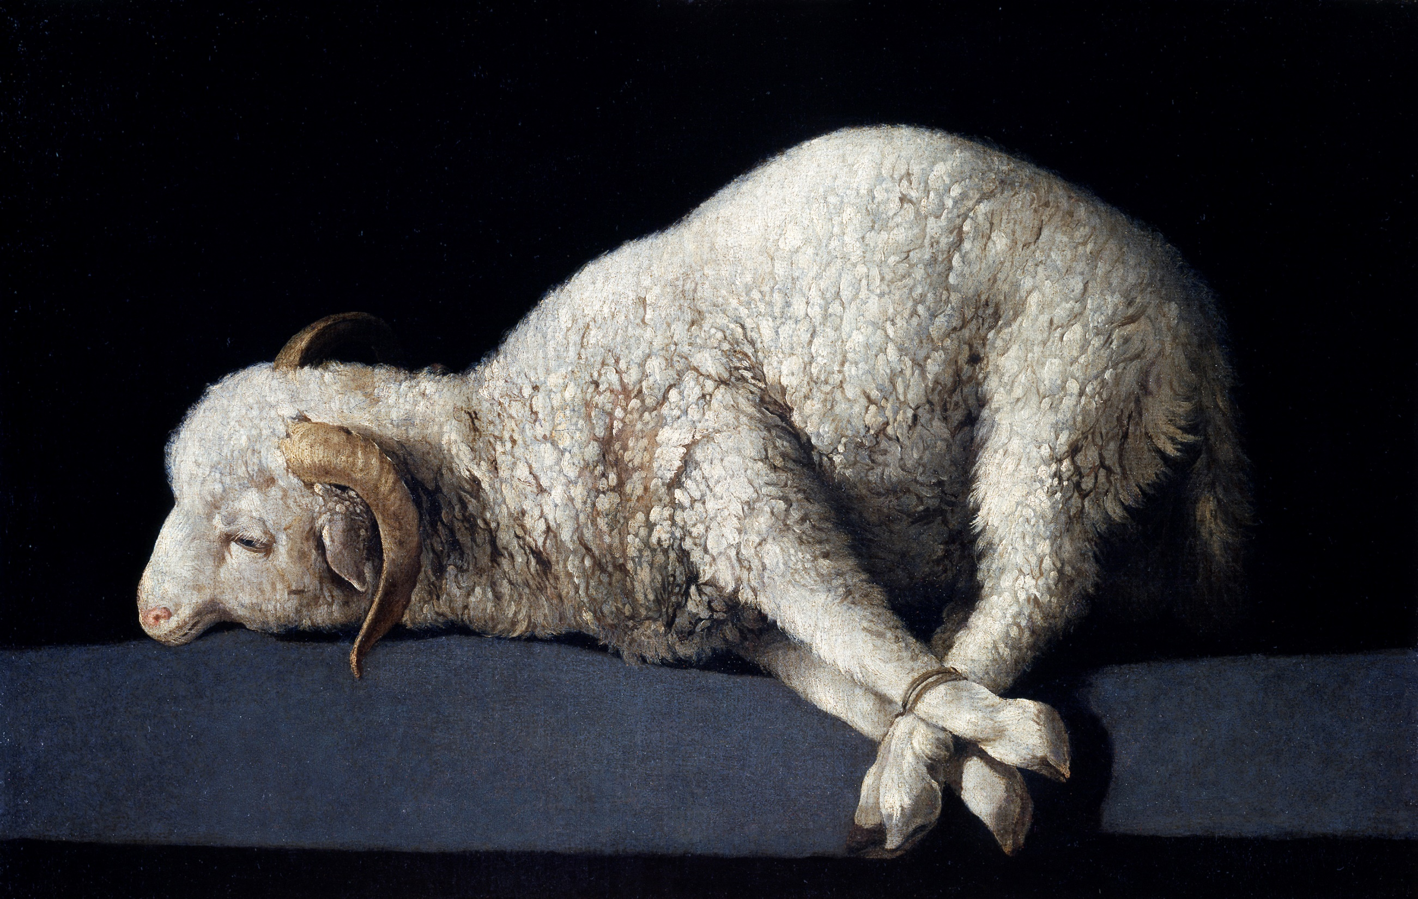
Passover

Slide 18
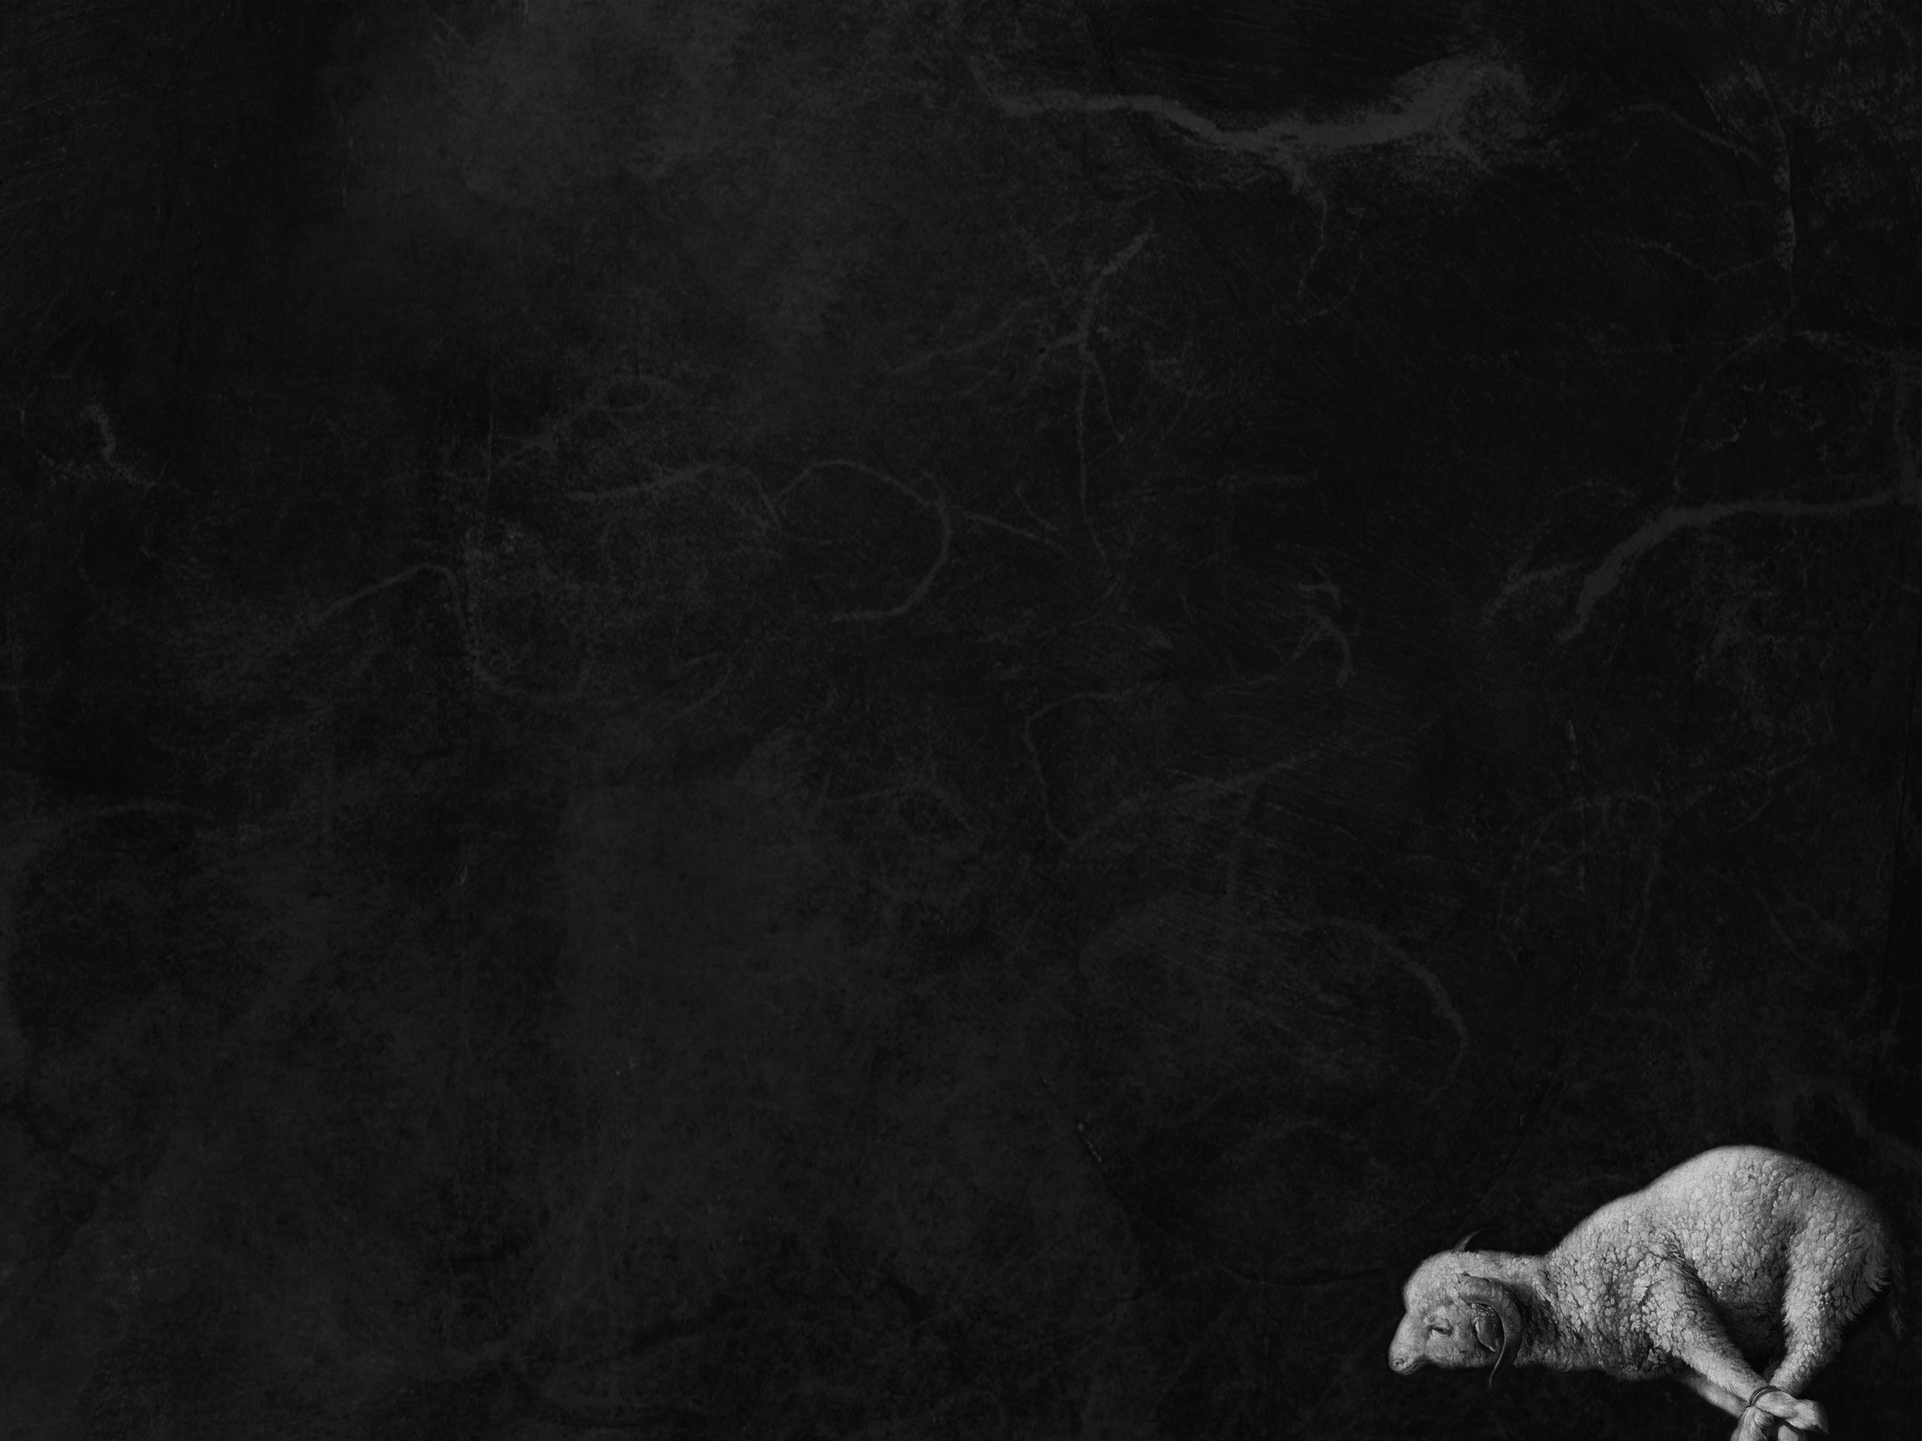
Leviticus 23:4-5
These are the appointed feasts of YHWH, the holy convocations, which you shall proclaim at the time appointed for them. In the first month, on the fourteenth day of the month at twilight, is YHWH’s Passover.

Slide 19
Exodus 12:3–6
Tell all the congregation of Israel that on the tenth day of this month every man shall take a lamb according to their fathers’ houses, a lamb for a household… Your lamb shall be without blemish, a male a year old. You may take it from the sheep or from the goats, and you shall keep it until the fourteenth day of this month, when the whole assembly of the congregation of Israel shall kill their lambs at twilight.

Slide 20
Exodus 12:7–11
Then they shall take some of the blood and put it on the two doorposts and the lintel of the houses in which they eat it. They shall eat the flesh that night, roasted on the fire; with unleavened bread and bitter herbs they shall eat it… In this manner you shall eat it: with your belt fastened, your sandals on your feet, and your staff in your hand. And you shall eat it in haste. It is YHWH’s Passover.

Slide 21
Exodus 12:12–14
For I will pass through the land of Egypt that night, and I will strike all the firstborn…
The blood shall be a sign for you, on the houses where you are. And when I see the blood, I will pass over you, and no plague will befall you to destroy you, when I strike the land of Egypt. This day shall be for you a memorial day, and you shall keep it as a feast to YHWH; throughout your generations, as a statute forever, you shall keep it as a feast.

Slide 22
Passover starts at sunset,
and ends at the following sunset.
Yeshua ate his Passover meal in the evening that began Passover.
Before the next sunset, on Passover day, he was nailed to cross, and became our Passover Lamb.
(Matthew 27)

Slide 23
1 Corinthians 5:7–8
Cleanse out the old leaven that you may be a new lump, as you really are unleavened. For Christ, our Passover lamb, has been sacrificed. Let us therefore celebrate the festival, not with the old leaven, the leaven of malice and evil, but with the unleavened bread of sincerity and truth.
Note: Corinth was mostly Gentile!

Slide 24
We celebrate in remembrance!
Even in the end times, during the millennium, we will still be celebrating the Passover:
Ezekiel 45:21
In the first month, on the fourteenth day of the month, you shall celebrate the Feast of the Passover.

Slide 25
Passover
Recalls the passing over of the destroyer - death to every household not covered by the blood of the sacrificed lamb
Looks forward to the sacrifice of Yeshua
on the very same day, when he was crucified as our sacrificial Lamb

Slide 26
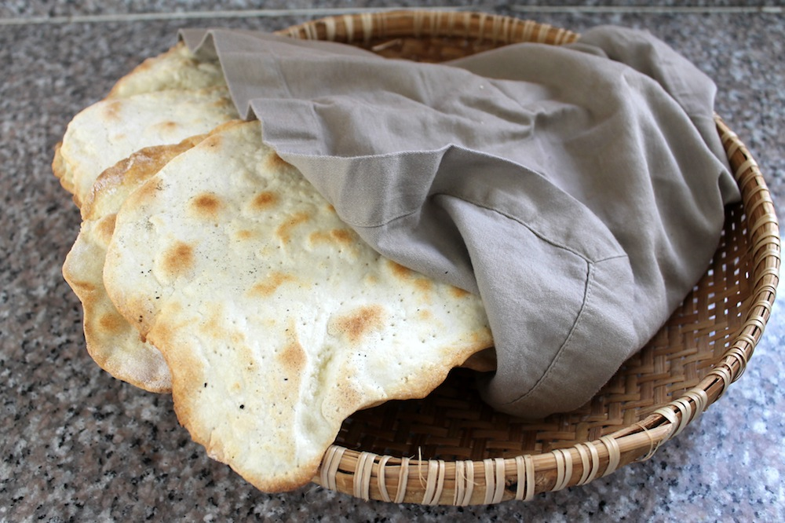
Unleavened Bread

Slide 27
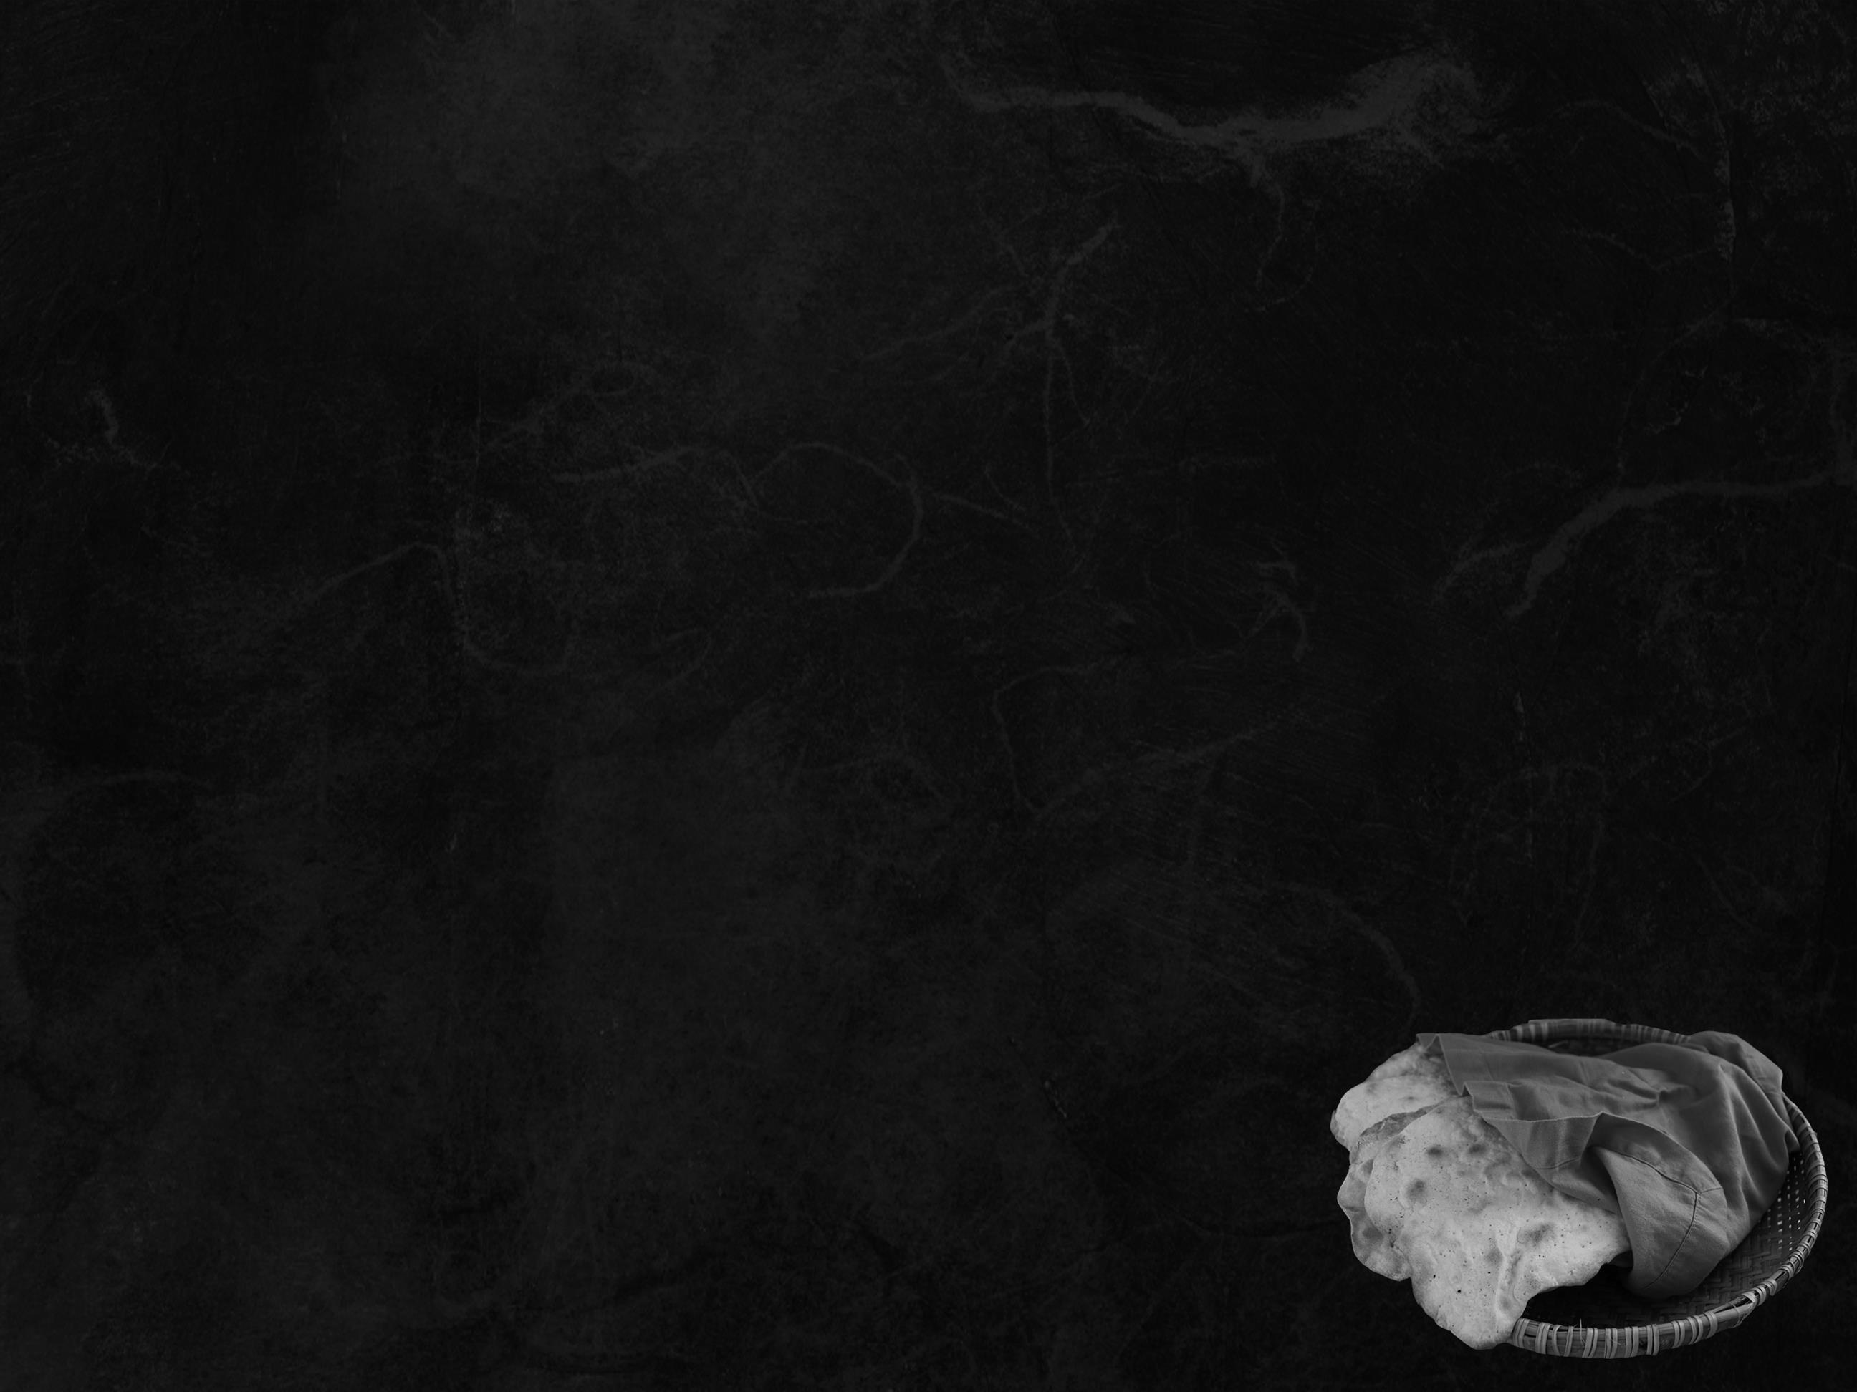
Leviticus 23:6-7
And on the fifteenth day of the same month is the feast of Unleavened Bread to YHWH; for seven days you shall eat unleavened bread. On the first day you shall have a holy convocation; you shall not do any ordinary work.

Slide 28
Exodus 12:7–11
Then they shall take some of the blood and put it on the two doorposts and the lintel of the houses in which they eat it. They shall eat the flesh that night, roasted on the fire; with unleavened bread and bitter herbs they shall eat it… In this manner you shall eat it: with your belt fastened, your sandals on your feet, and your staff in your hand.
And you shall eat it in haste.
It is YHWH’s Passover.

Slide 29
Exodus 12:15–16
Seven days you shall eat unleavened bread. On the first day you shall remove leaven out of your houses, for if anyone eats what is leavened, from the first day until the seventh day, that person shall be cut off from Israel. On the first day you shall hold a holy assembly, and on the seventh day a holy assembly. No work shall be done on those days. But what everyone needs
to eat, that alone may be
prepared by you.

Slide 30
Exodus 12:17–18
And you shall observe the Feast of Unleavened Bread, for on this very day I brought your hosts out of the land of Egypt. Therefore you shall observe this day, throughout your generations, as a statute forever. In the first month, from the fourteenth day of the month at evening, you shall eat unleavened bread until the twenty-first day of the month at evening.

Slide 31
Firstborn was killed… then deliverance began
This foreshadowed Yeshua, the firstborn
of YHWH being killing, initiating deliverance.
Colossians 1:15
He is the image of the invisible God, the firstborn of all creation.

Slide 32
Unleavened bread – God’s provision during the time of deliverance – “the Great Escape!”
Yeshua, the bread of life.
John 6:51
I am the living bread that came down from heaven. If anyone eats of this bread, he will live forever. And the bread that I
will give for the life of the world
is my flesh.

Slide 33
Leaven – symbolic of sin
Yeshua is unleavened bread!
Mark 8:15
Watch out; beware of the leaven of the Pharisees and the leaven of Herod.
1 Corinthians 5:8
Celebrate the festival, not with the old leaven, the leaven of malice and evil, but
with the unleavened bread of
sincerity and truth.

Slide 34
Unleavened Bread:
The great escape – through the Red Sea.
The process of deliverance!
On the first day of Unleavened Bread,
Yeshua spend his first day in the tomb!
His body broken for us, buried in the tomb, like a seed in the ground, that it might sprout forth new life again. He literally went through
the valley of death, to emerge into
new life on the other side.

Slide 35
During the millennium, we will still celebrate Unleavened Bread!
Ezekiel 45:21
In the first month, on the fourteenth day of the month, you shall celebrate the Feast of the Passover, and for seven days unleavened bread shall be eaten.

Slide 36
Unleavened Bread
Provision during deliverance from Egypt,
the beginning of their great escape
(into the depths of the Red Sea)
Unleavened bread = sinless Messiah
Yeshua = Bread of Life
His body buried on the very same day,
like seed planted to raise up new life

Slide 37
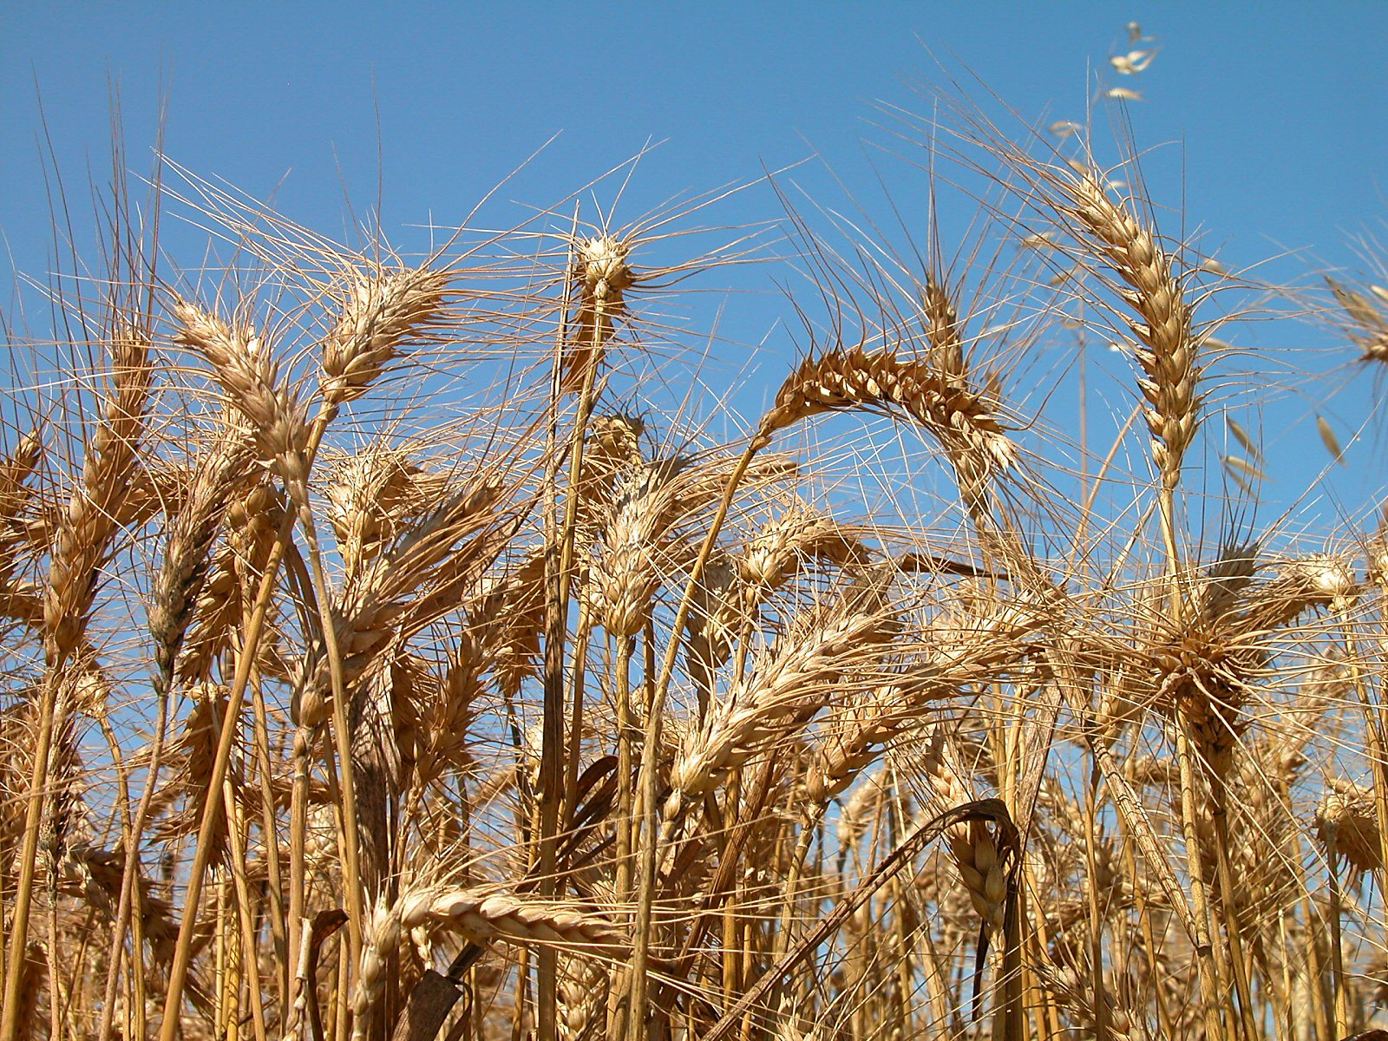
Firstfruits

Slide 38
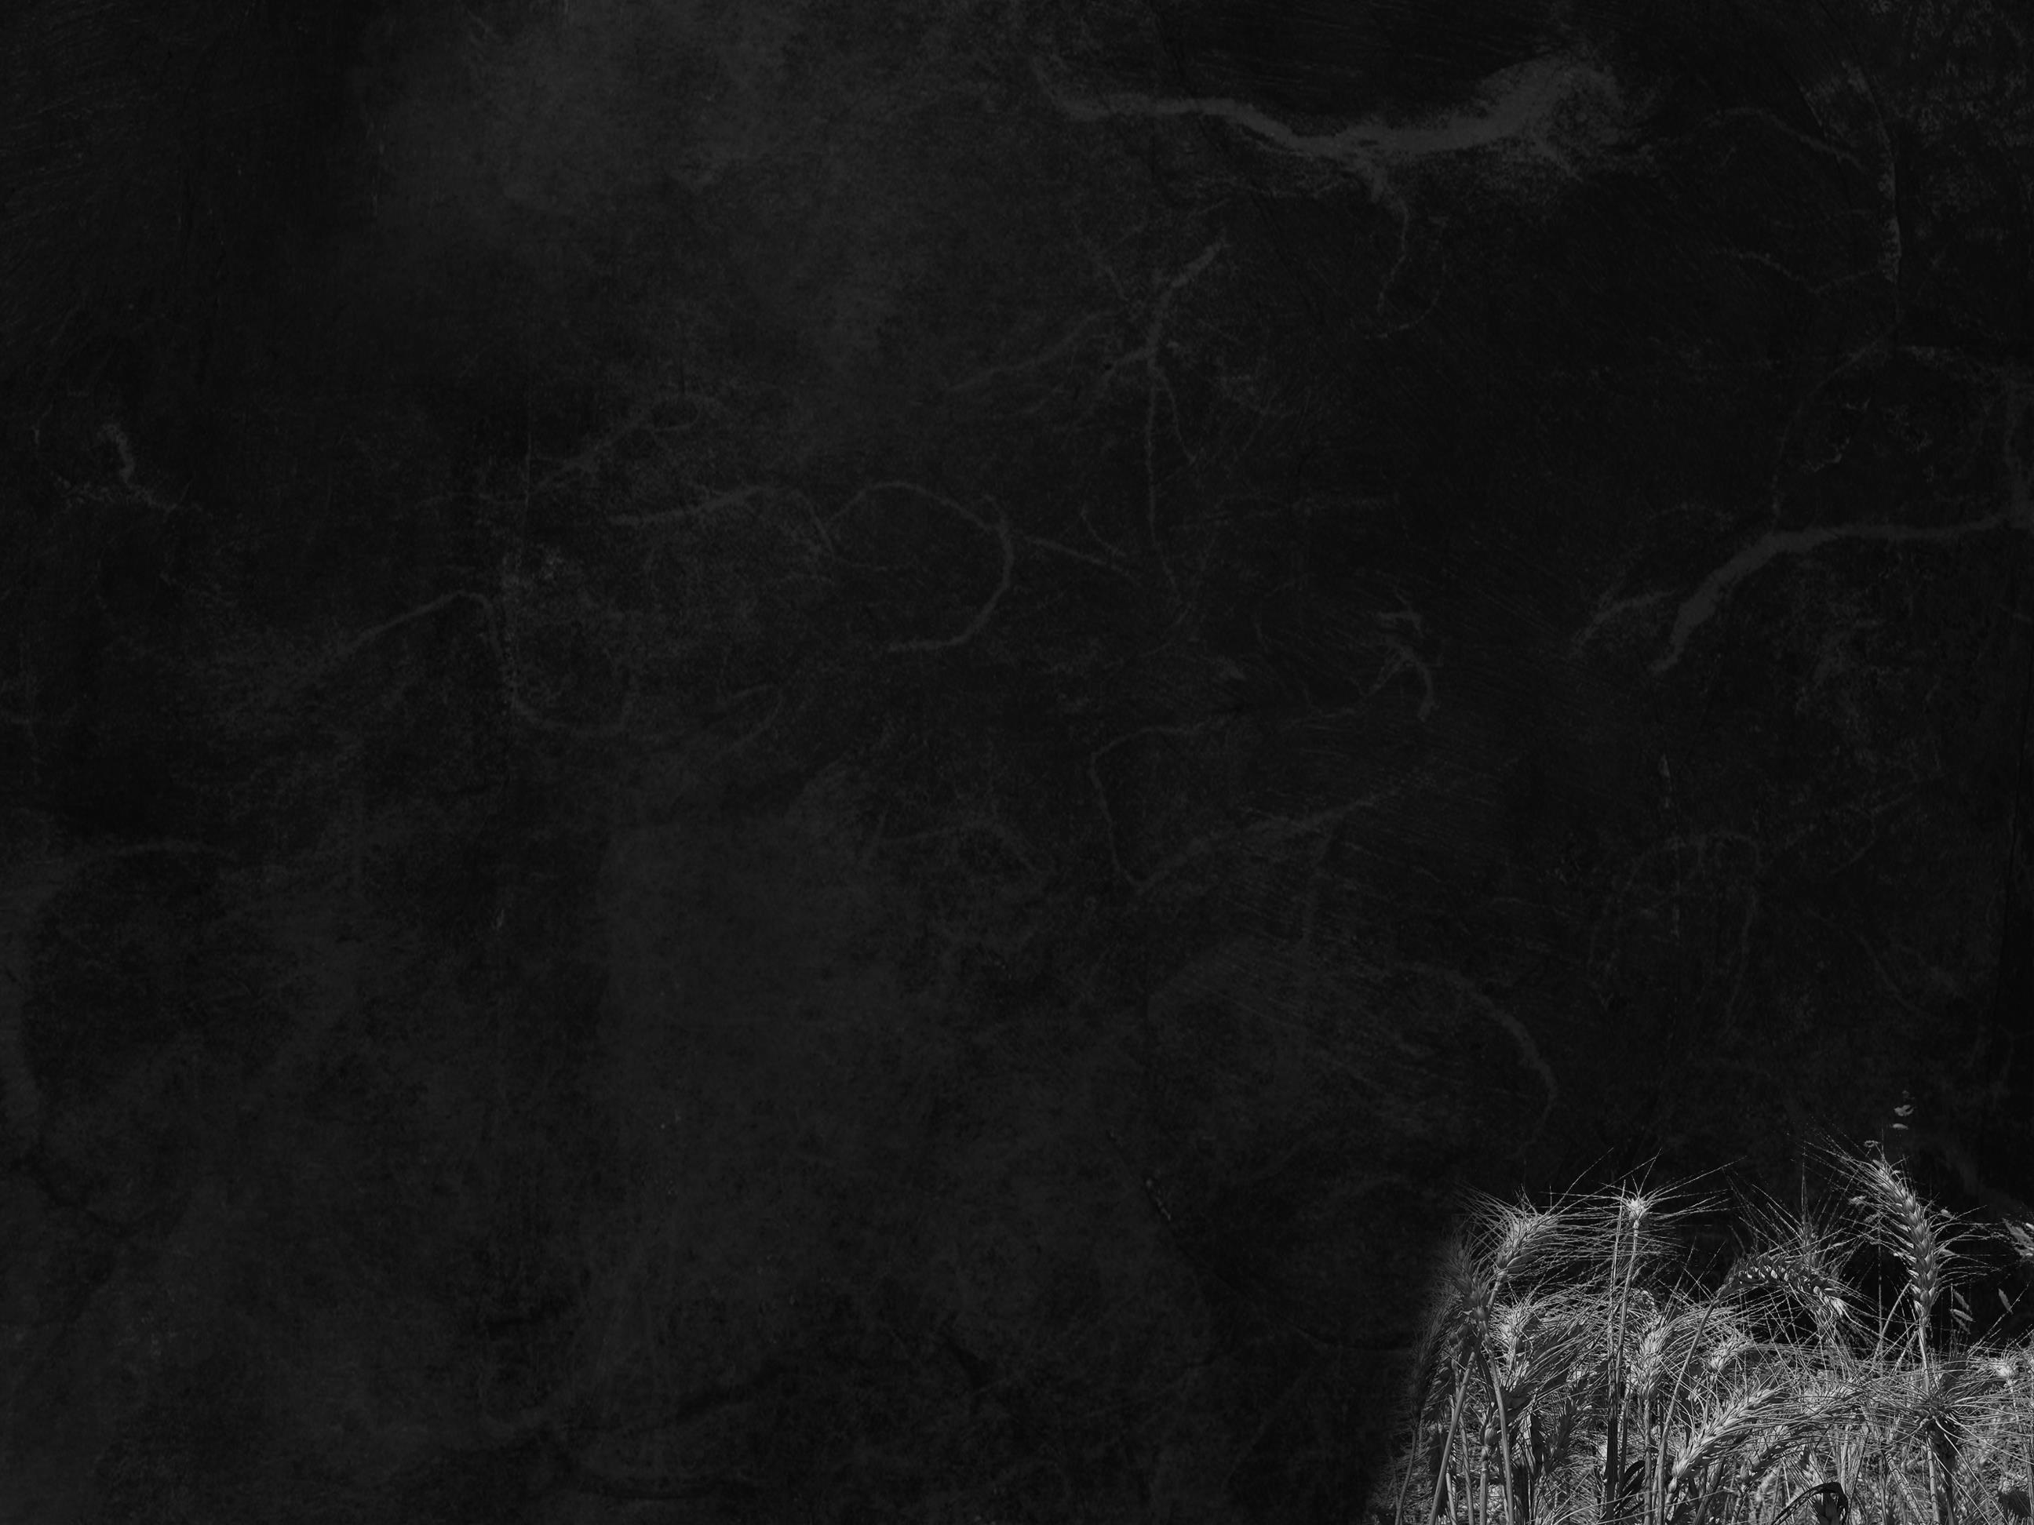
Leviticus 23:9-11
And YHWH spoke to Moses, saying, “Speak to the people of Israel and say to them, When you come into the land that I give you and reap its harvest, you shall bring the sheaf of the firstfruits of your harvest to the priest, and he shall wave the sheaf before
YHWH, so that you may be accepted. On the day after the Sabbath
the priest shall wave it.

Slide 39
The firstfruit of the first harvest is lifted up as an offering to YHWH.
This was the barley harvest.

Slide 40
Yeshua, the Bread of Life, broken and buried, was raised up as the firstfruit of the harvest.
1 Corinthians 15:20
But in fact Christ has been raised
from the dead, the firstfruits of
those who have fallen asleep.

Slide 41
Firstfruits = Resurrection Day
Offering the firstfruits of the first harvest
Yeshua resurrected on the very same day, becoming the Firstfruits of the spiritual harvest of the earth

Slide 42
Yeshua and the
Spring Appointed Times

Slide 43
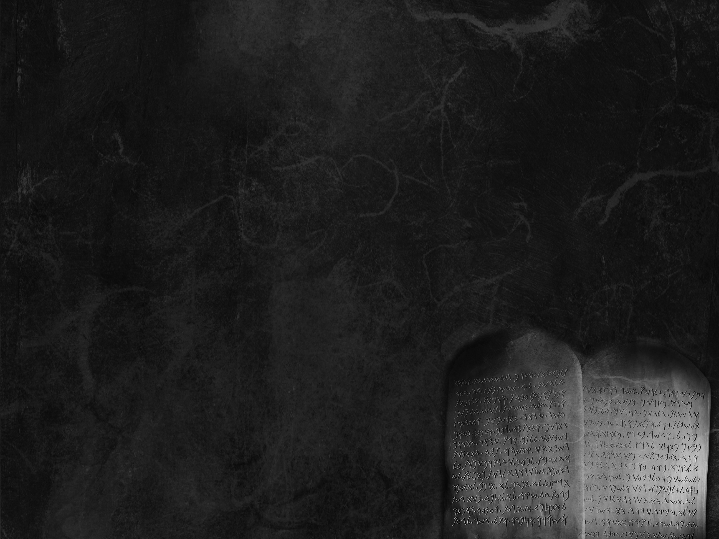
3 Spring Appointed Times
Passover – Crucifixion
Unleavened Bread – Burial
Firstfruits – Resurrection
Barley
Harvest
Wheat
Harvest
Shavuot (Weeks)
3 Fall Appointed Times
Trumpets
Atonement
Sukkot
Final
Harvest

Slide 44
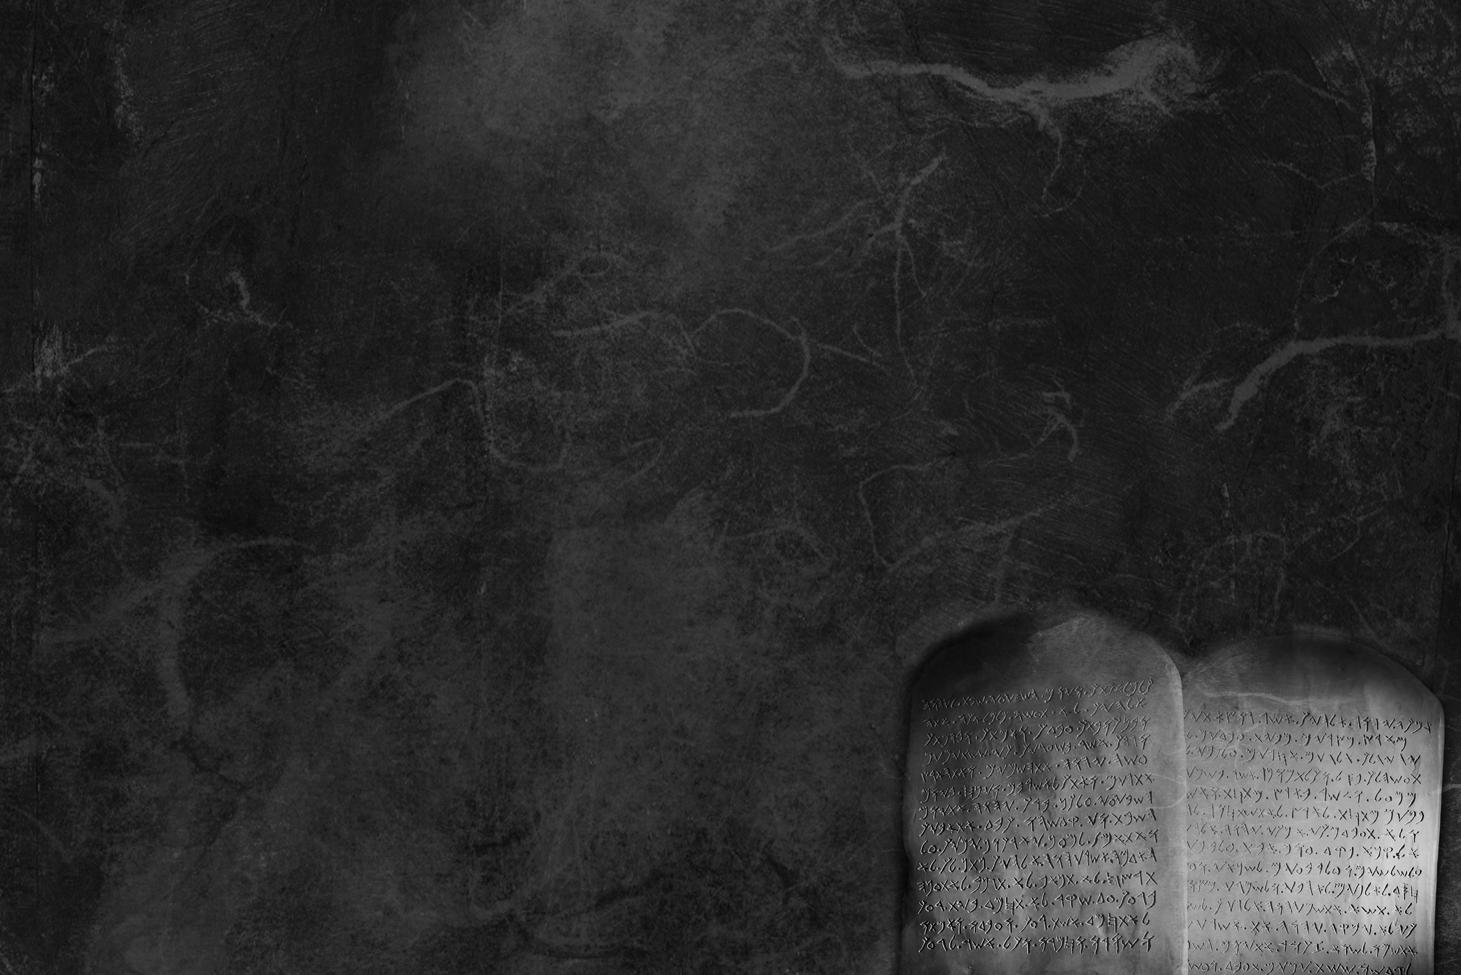
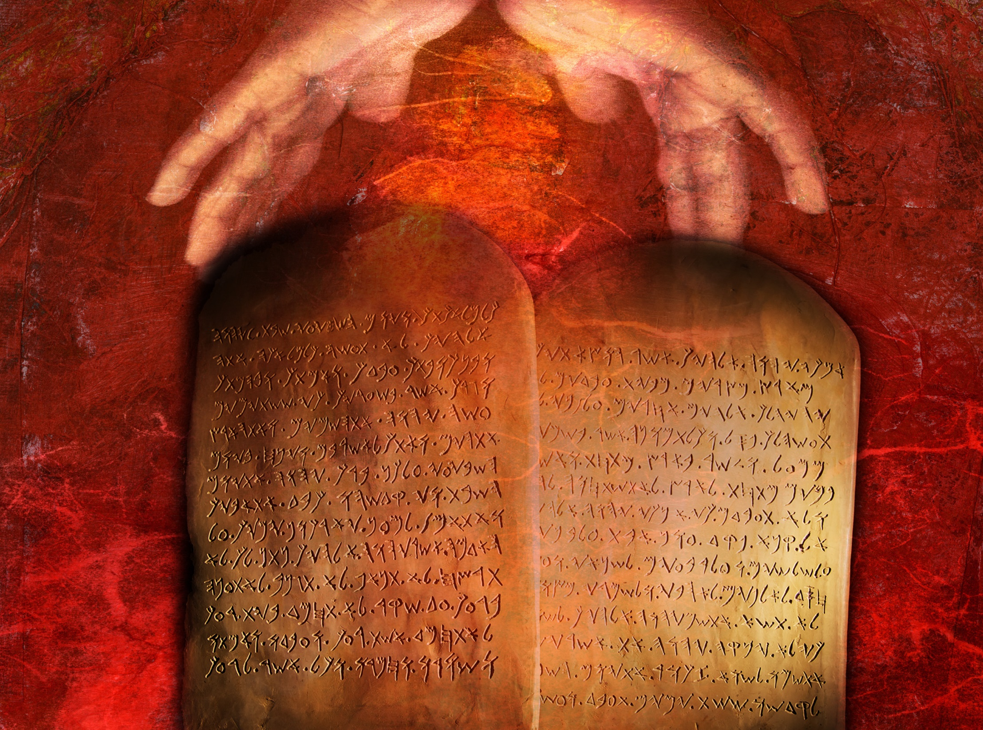
Shavuot (Weeks)

Slide 45
Leviticus 23:15-16, 21
You shall count seven full weeks from the day after the Sabbath, from the day that you brought the sheaf of the wave offering. You shall count fifty days to the day after the seventh Sabbath. Then you shall present a grain offering of new grain to YHWH…
You shall hold a holy convocation. You shall not do any ordinary
work. It is a statute forever
in all your dwelling places
throughout your generations.

Slide 46
According to tradition:
Shavuot took place when the Ten Words were given to Moses on Mt Sinai.
Scripture supports this tradition.

Slide 47
Exodus 19:1
On the third new moon after the people of Israel had gone out of the land of Egypt, on that day they came into the wilderness of Sinai.

Slide 48
Day 1. Arrive at Sinai
Day 2. Moses up & down mountain

Slide 49
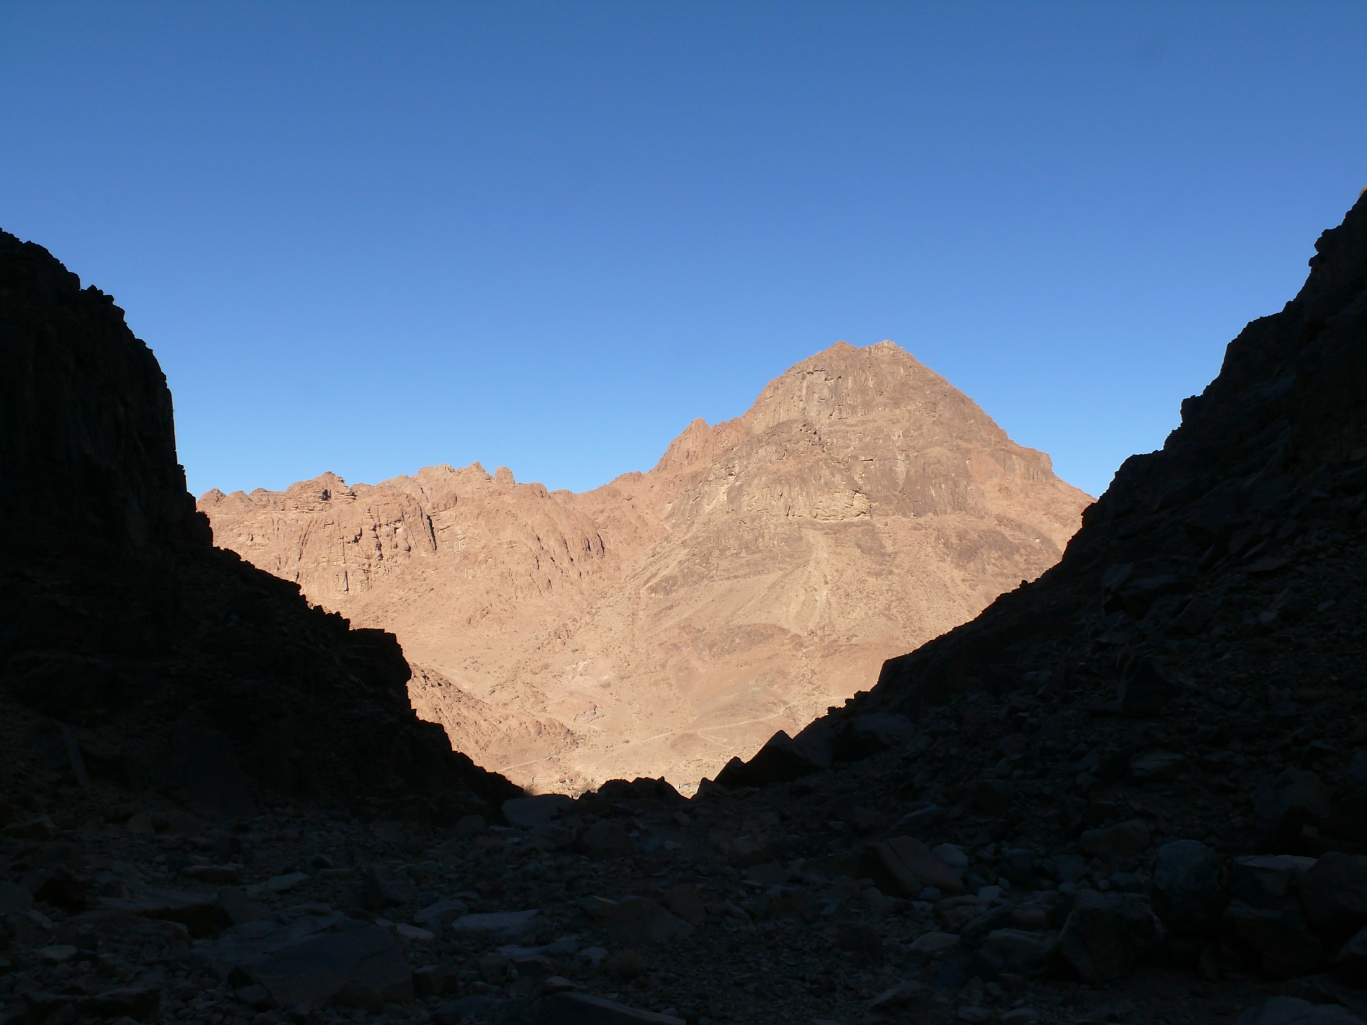
Mt. Sinai (traditional location)

Slide 50
Day 1. Arrive at Sinai
Day 2. Moses up & down mountain
Day 3. Moses up & down mountain
1st day of preparation
Day 4. 2nd day of preparation
Day 5. 3nd day of preparation
Moses up & down mt.
Day 6. Moses & Aaron go up
YHWH speaks

Slide 51
Timing of Shavuot & the Ten Words

Slide 52
Timing of Shavuot & the Ten Words

Slide 53
Timing of Shavuot & the Ten Words

Slide 54
Ex 20:2
I am YHWH your God, who brought you out of the land of Egypt.
Ex 20:3
You shall have no other gods before me.
Ex 20:7
You shall not take the name of YHWH your God in vain.

Slide 55
Ex 20:8
Remember the Sabbath day, to keep it holy. Six days you shall labor, and do all your work, but the seventh day is a Sabbath to YHWH your God. On it you shall not do any work.
Ex 20:12
Honor your father and your mother.
Ex 20:13
You shall not murder.

Slide 56
Ex 20:14
You shall not commit adultery.
Ex 20:15
You shall not steal.
Ex 20:16
You shall not bear false witness against your neighbor.
Ex 20:17
You shall not covet.

Slide 57
Exodus 20:18
Now when all the people saw the thunder and the flashes of lightning and the sound of the trumpet and the mountain smoking, the people were afraid and trembled, and they stood far off.
Exodus 20:22
And YHWH said to Moses... “You have seen for yourselves that I have talked with you from heaven.”

Slide 58
850 years later, Ezekiel sees a vision of heaven with very similar imagery:
Ezekiel 1:1
In the thirtieth year, in the fourth month, on the fifth day of the month, as I was among the exiles by the Chebar canal, the heavens were opened, and I
saw visions of God.

Slide 59
Ezekiel 1:4
As I looked, behold, a stormy wind came out of the north, and a great cloud, with brightness around it, and fire flashing forth continually, and in the midst of the fire, as it were gleaming metal.

Slide 60
Ezekiel 1:13-14
As for the likeness of the living creatures, their appearance was like burning coals of fire, like the appearance of torches moving to and fro among the living creatures. And the fire was bright, and out of the fire went forth lightning.

Slide 61
Ezekiel 1:24
And when they went, I heard the sound of their wings like the sound of many waters, like the sound of the Almighty, a sound of tumult like the sound of an army.

Slide 62
Every year at Shavuot, God’s people gathered together and read these very passages from Exodus and Ezekiel.
Exactly 7 weeks after Yeshua had arisen on Firstfuits, the people were all gathered in Jerusalem to celebrate Shavuot.
They would have been
reading these passages.

Slide 63
Acts 2:1
When the day of Pentecost arrived, they were all together in one place.
Pentecost = Shavuot
Greek: pentecoste “fiftieth”
counting 50 days
Hebrew: shavuot “weeks”
counting 7 weeks

Slide 64
Acts 2:1-4
When the day of Pentecost arrived, they were all together in one place. And suddenly there came from heaven a sound like a mighty rushing wind, and it filled the entire house where they were sitting. And divided tongues as of fire appeared to them and rested on each one of them.
And they were all filled with the
Holy Spirit and began to speak
in other tongues as the Spirit
gave them utterance.

Slide 65
Ezekiel 36:26–27
And I will give you a new heart, and a new spirit I will put within you. And I will remove the heart of stone from your flesh and give you a heart of flesh. And I will put my Spirit within you, and cause you to walk in my statutes and be careful to obey my rules.

Slide 66
Shavuot (Weeks, Pentecost)
Initiated the wheat harvest – new grain
Recalls giving of Torah on tablets of stone
God gave His Spirit on the very same day, when He wrote his Torah on our hearts
Sign of the new covenant
initiating a new spiritual harvest

Slide 67
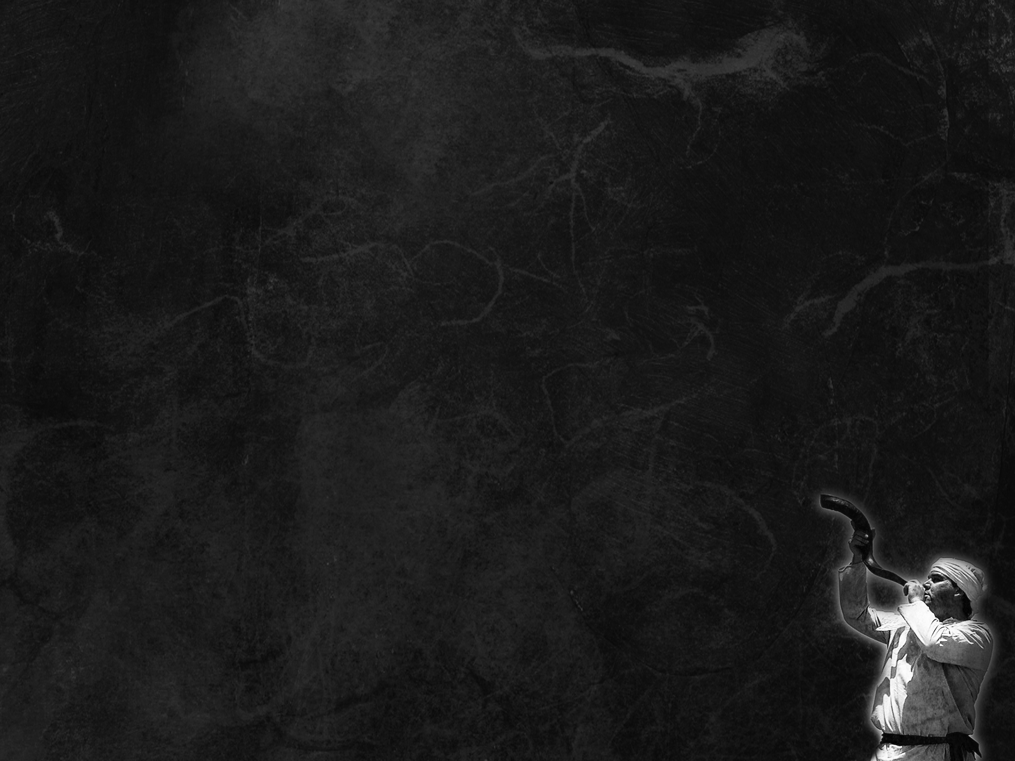
3 Spring Appointed Times
Passover – Crucifixion
Unleavened Bread – Burial
Firstfruits – Resurrection
Barley
Harvest
Shavuot (Pentecost) – Holy Spirit
Wheat
Harvest
3 Fall Appointed Times
Trumpets
Atonement
Sukkot
Final
Harvest

Slide 68
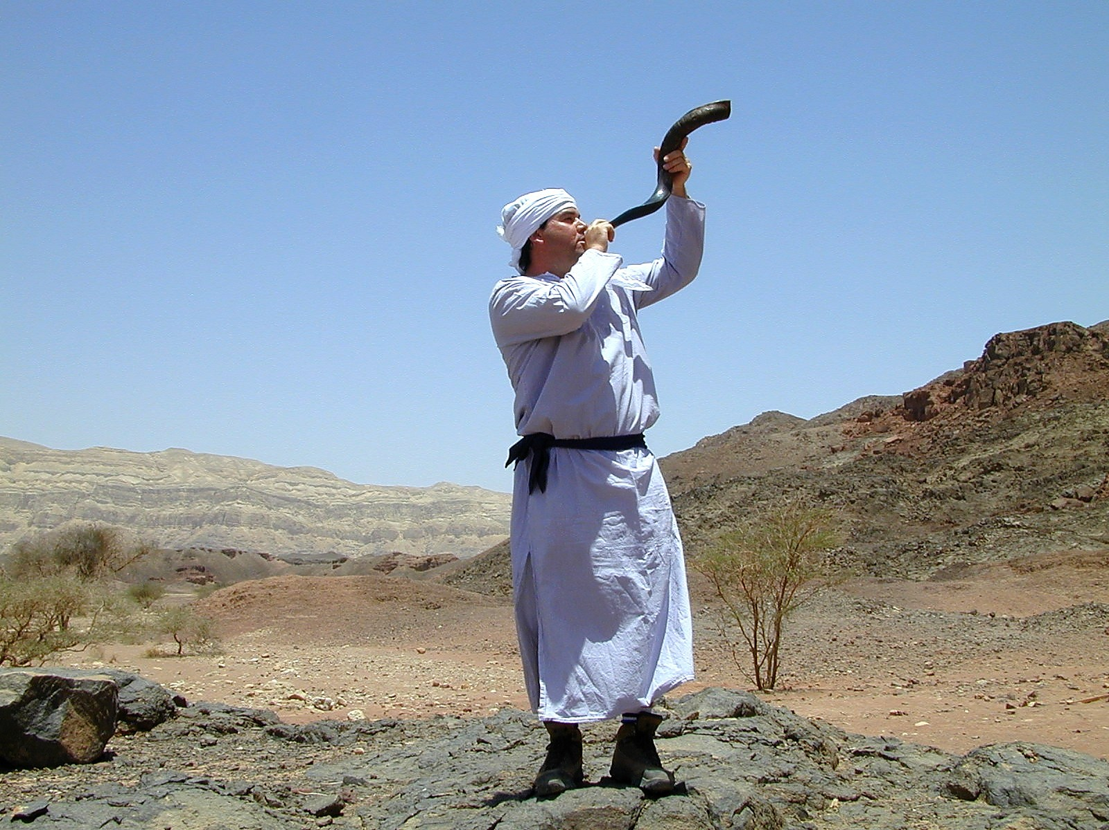
Yom Teruah

Slide 69

Leviticus 23:24-25
Speak to the people of Israel, saying, In the seventh month, on the first day of the month, you shall observe a day of solemn rest, a memorial proclaimed with blast of trumpets, a holy convocation. You shall not do any ordinary work, and you shall present a food offering to YHWH.

Slide 70
The trumpet is blown for:
Gathering people for an Appointed Time
Gathering people for Battle
The crowning of a King
The anointing of a High Priest
The arrival of the Bridegroom

Slide 71
Matthew 24:29-31
Immediately after the tribulation of those days… will appear in heaven the sign of the Son of Man, and then all the tribes of the earth will mourn, and they will see the Son of Man coming on the clouds of heaven with power and great glory. And he will send out his angels with a loud trumpet call, and they will gather his elect from the four winds,
from one end of heaven to the other.

Slide 72
I Corinthians 15:51-52
Behold! I tell you a mystery. We shall not all sleep, but we shall all be changed, in a moment, in the twinkling of an eye, at the last trumpet. For the trumpet will sound, and the dead will be raised imperishable, and we shall be changed.

Slide 73
Revelation 11:15-17
Then the seventh angel blew his trumpet, and there were loud voices in heaven, saying, “The kingdom of the world has become the kingdom of our Lord and of his Christ, and he shall reign forever and ever.” And the twenty-four elders who sit on their thrones before God fell on their faces and worshiped God, saying, “We give thanks to you, Lord
God Almighty, who is and who was,
for you have taken your great power
and begun to reign.

Slide 74
Day of Trumpets:
Gathering people for Appointed Time
Gathering people for Battle
The crowning of a King
The anointing of a High Priest
The arrival of the Bridegroom
Looks forward to Yeshua’s 2nd coming,
on the very same day ??

Slide 75
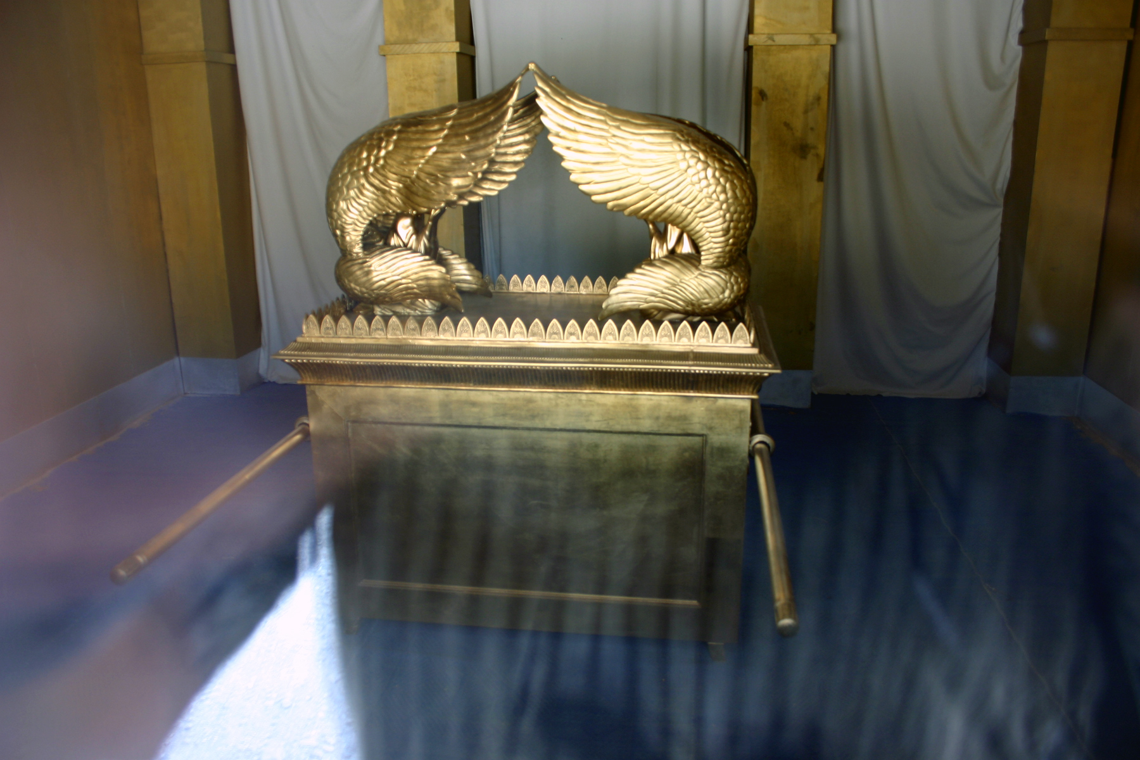
Yom Kippur

Slide 76
Yom Kippur
Day of Atonement
(Day of Covering)

Slide 77
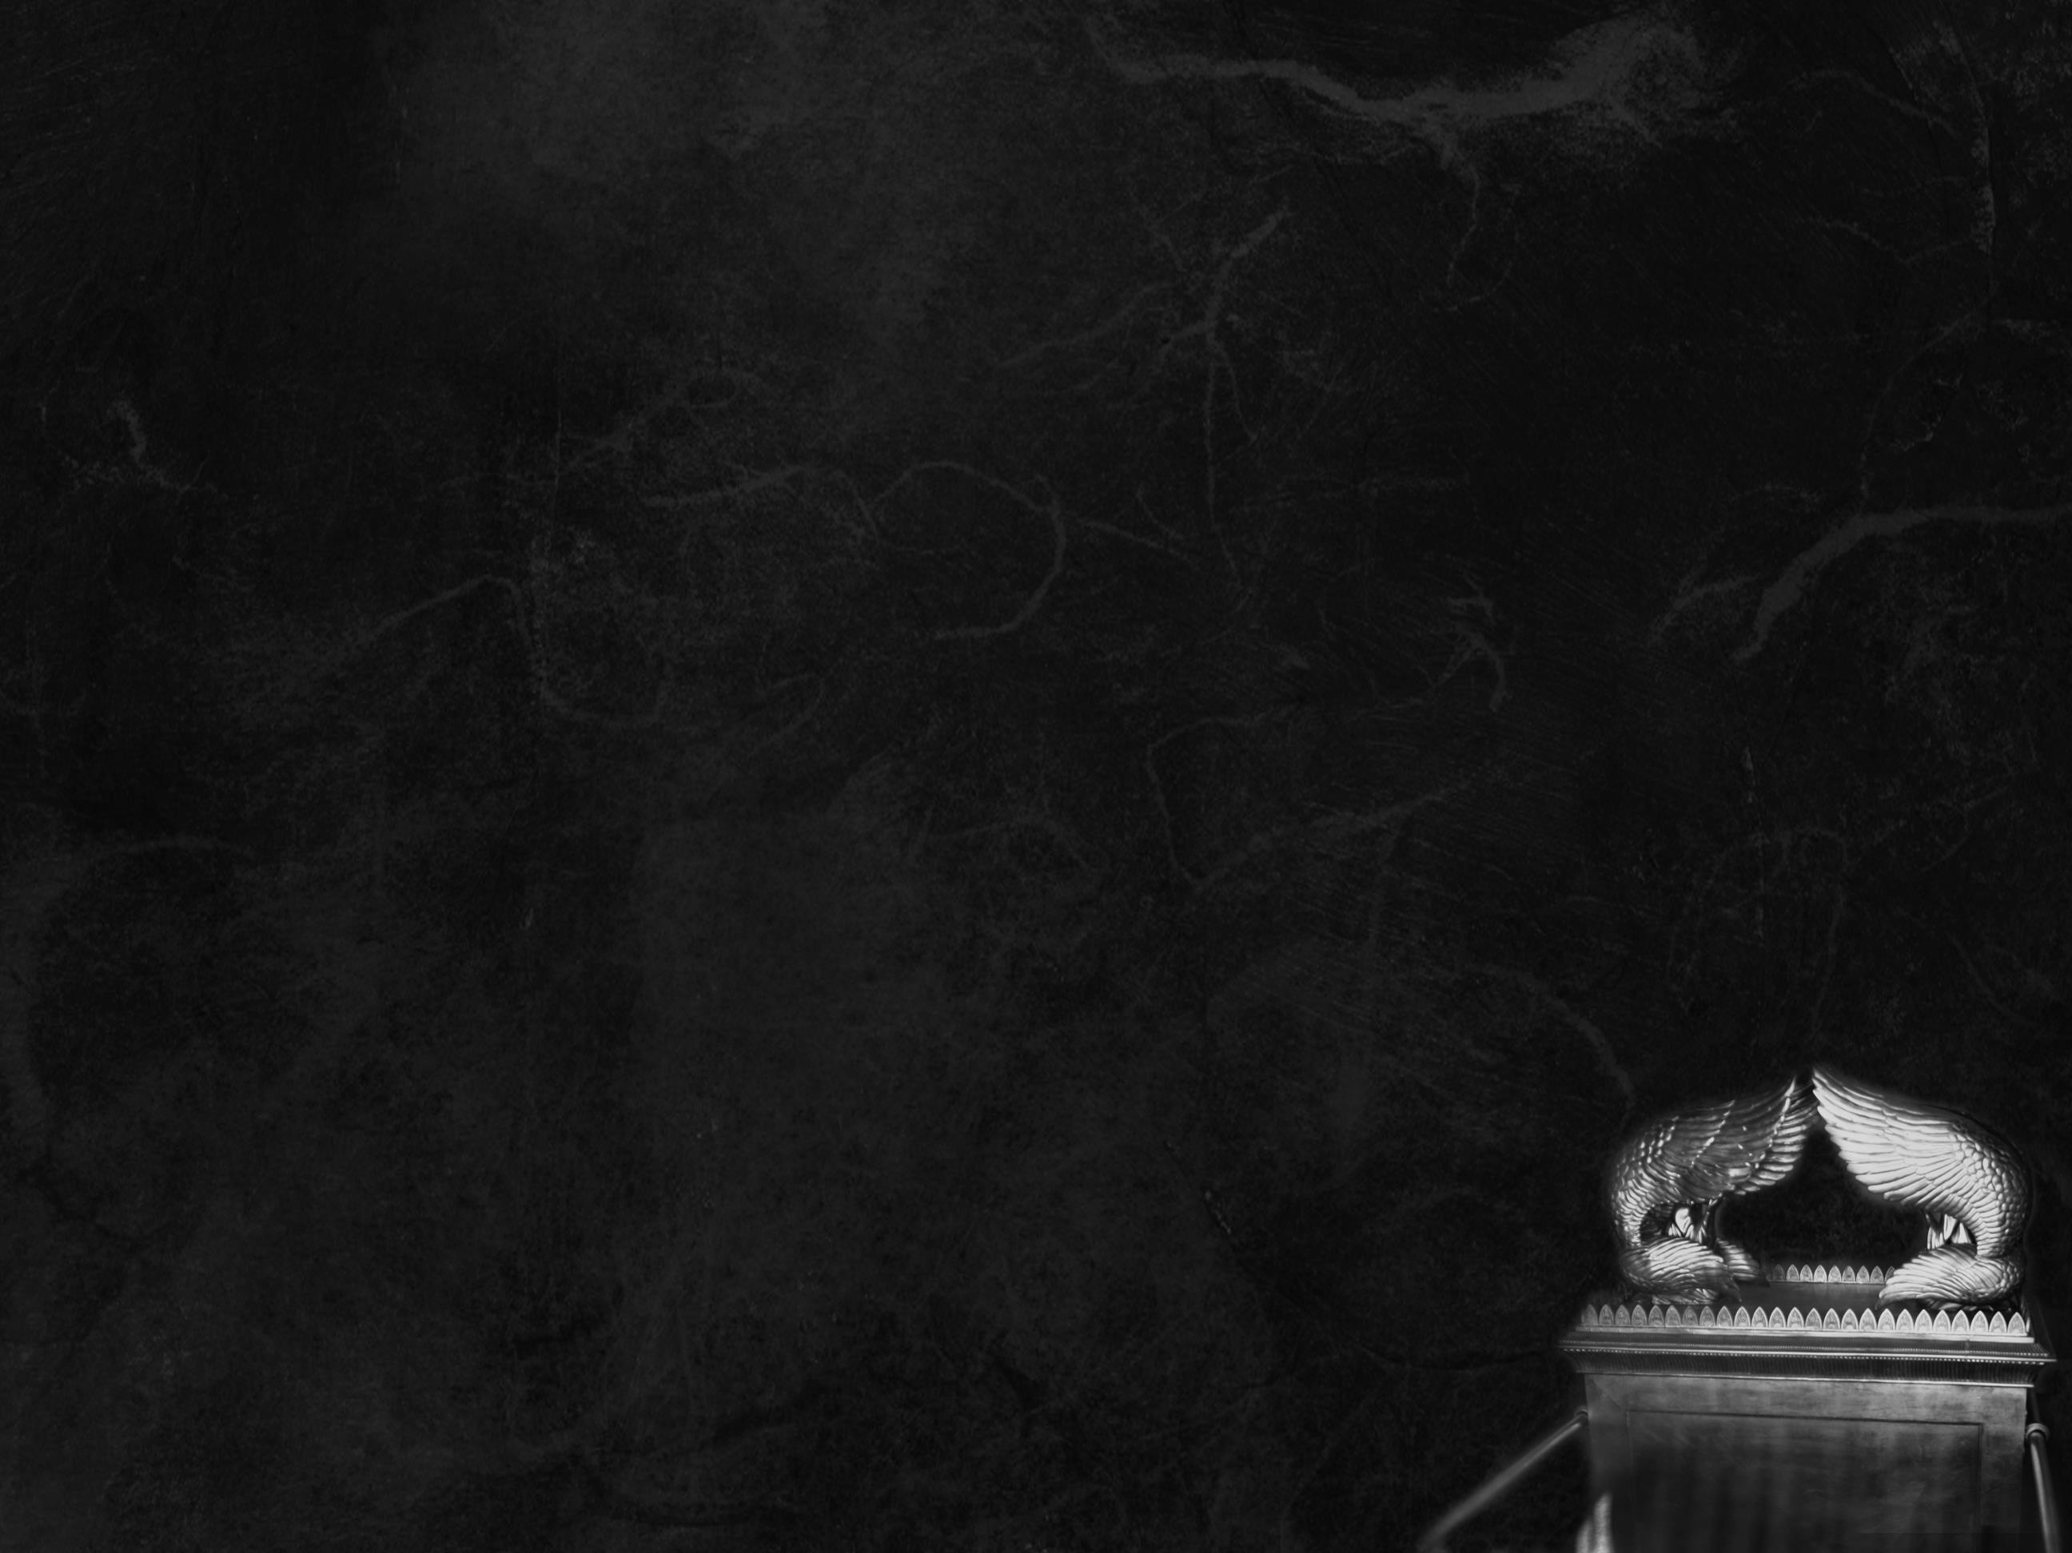
Leviticus 23:27-31
Now on the tenth day of this seventh month is the Day of Atonement. It shall be for you a time of holy convocation, and you shall afflict yourselves and present a food offering to YHWH. And you shall not do any work on that very day, for it is a Day of Atonement, to make atonement for you before YHWH your God… It is a statute forever throughout
your generations in all your dwelling
places.

Slide 78
afflict = humble Hebrew עָנָה (‘anah)
Clearly tied to fasting in Scripture:
Ezra 8:21
Then I proclaimed a fast there, at the river Ahava, that we might humble ourselves before our God, to seek from him a safe journey for ourselves, our children,
and all our goods.

Slide 79
Day of Atonement
The High Priest in the Holy of Holies
Stands in the very presence of YHWH
He would die if his sins were not atoned for!
(Rope and bell attached to High Priest.)
Symbolizes our standing before YHWH
at judgment day, when either our
sins are atoned for, or we face His judgment.

Slide 80
Revelation 11:18-19
The nations raged, but your wrath came, and the time for the dead to be judged, and for rewarding your servants, the prophets and saints, and those who fear your name, both small and great, and for destroying the destroyers of the earth. Then God’s temple in heaven was opened, and the ark of his covenant was seen within his temple. There were flashes of lightning, rumblings,
peals of thunder, an earthquake,
and heavy hail.

Slide 81
Revelation 14:7
And he said with a loud voice, “Fear God and give him glory, because the hour of his judgment has come, and worship him who made heaven and earth, the sea and the springs of water.”

Slide 82
Revelation 14:14-16
Then I looked, and behold, a white cloud, and seated on the cloud one like a son of man, with a golden crown on his head, and a sharp sickle in his hand. And another angel came out of the temple, calling with a loud voice to him who sat on the cloud, “Put in your sickle, and reap, for the hour to reap has come, for the harvest of the earth is fully ripe.” So he who sat on the cloud swung his sickle
across the earth, and the earth
was reaped.

Slide 83
Revelation 14:18-19
And another angel came out from the altar, the angel who has authority over the fire, and he called with a loud voice to the one who had the sharp sickle, “Put in your sickle and gather the clusters from the vine of the earth, for its grapes are ripe.” So the angel swung his sickle across the earth and gathered the grape harvest of the earth and threw it into the great winepress of the wrath of God.

Slide 84
Day of Atonement
Recalls High Priest going into the Holy of Holies to stand in God’s presence
The High Priest would either live or die in God’s presence
Symbolizes Judgment Day, when on the very same day?? we will stand before God to either live or die in His presence

Slide 85
The end of the Final Harvest
Grapes, olives, dates, pomegranates
The day of God’s wrath
A day to rejoice
A day to fear
What comes after the final harvest?
Sukkot !

Slide 86
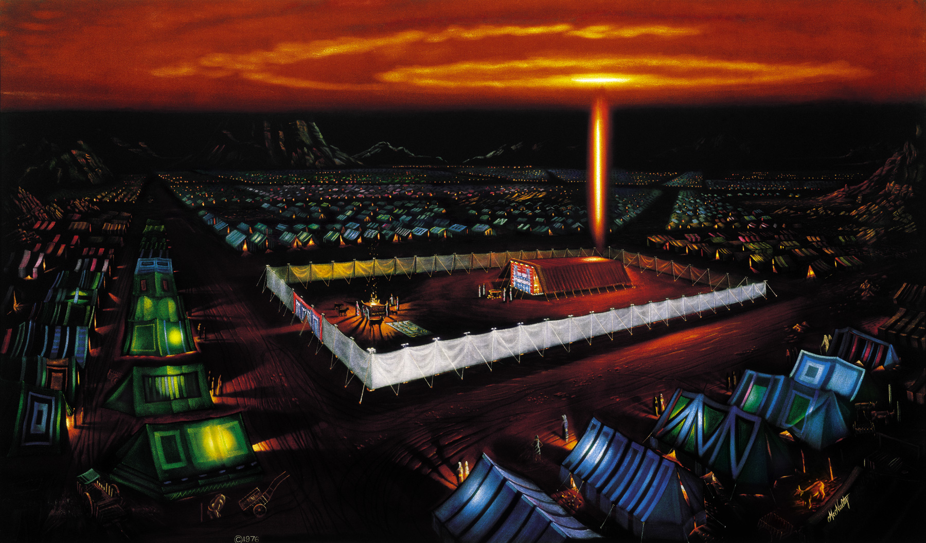
Sukkot (Booths)

Slide 87
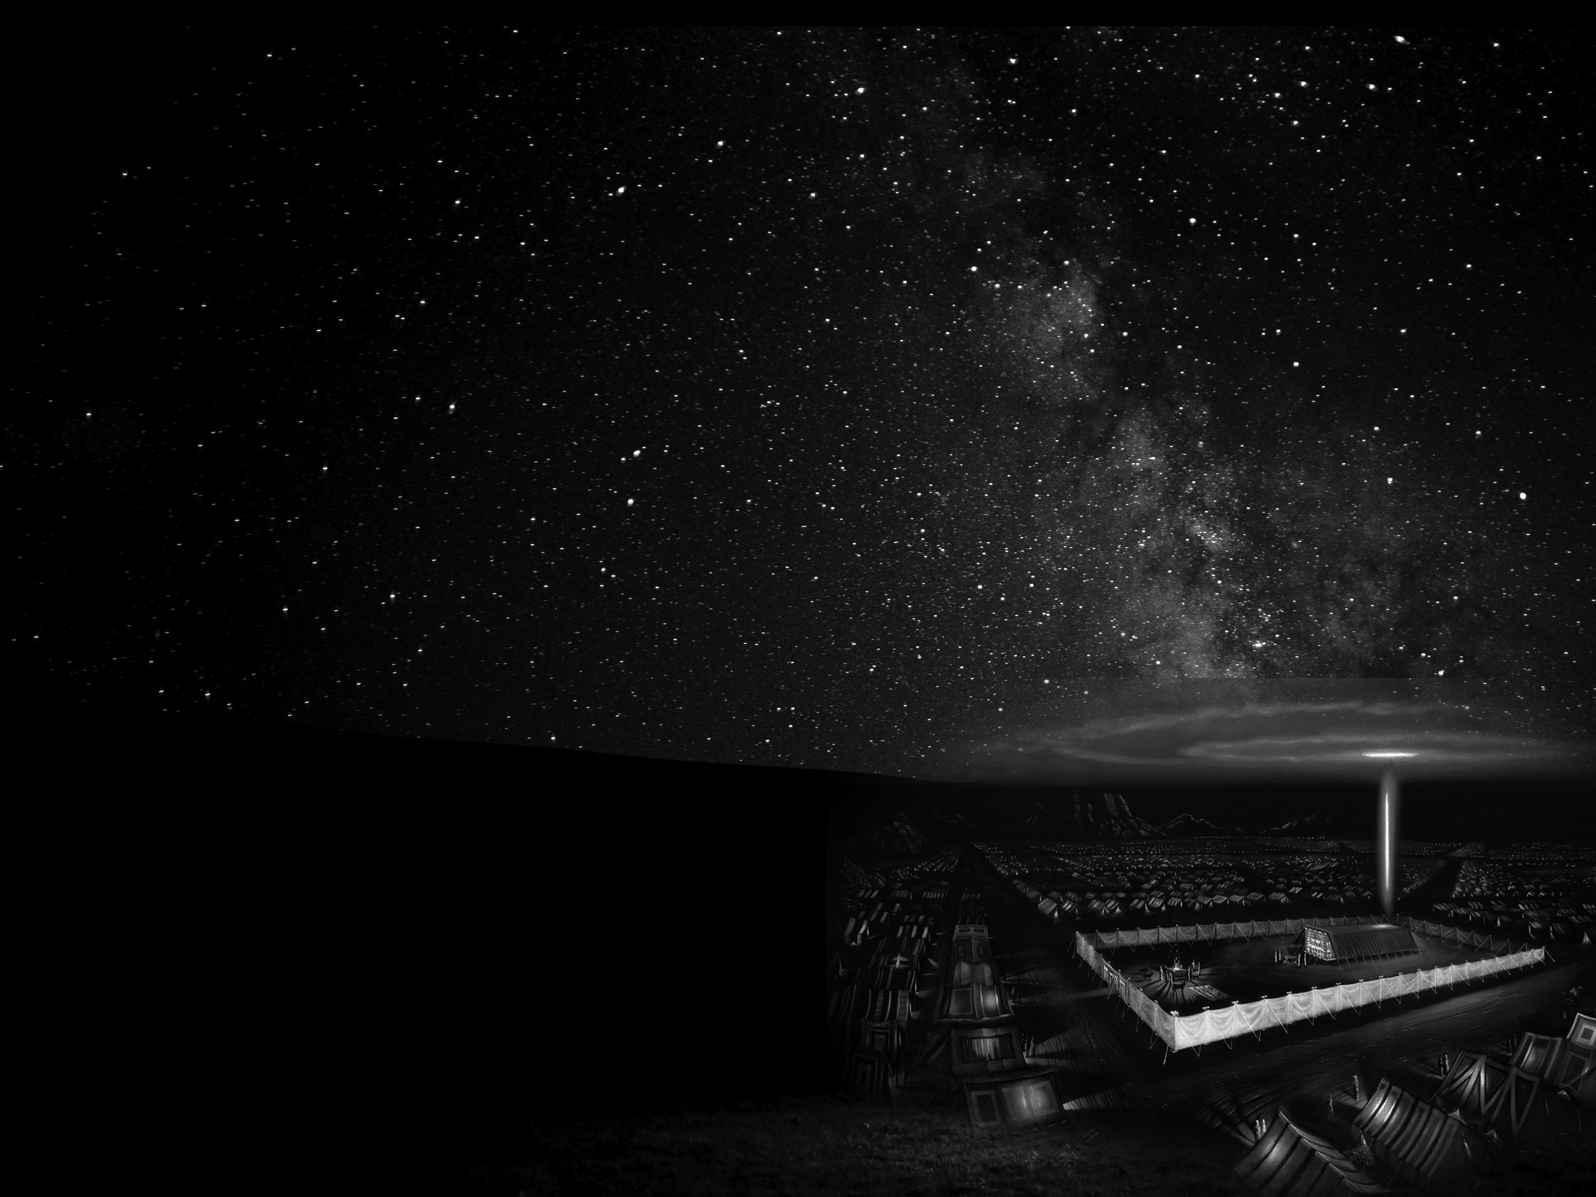
Leviticus 23:34-36
On the fifteenth day of this seventh month and for seven days is the Feast of Booths to YHWH. On the first day shall be a holy convocation; you shall not do any ordinary work. For seven days you shall present food offerings to YHWH. On the eighth day you shall hold a holy convocation and present a food offering to YHWH. It is a solemn assembly; you shall not do any ordinary work.

Slide 88
Leviticus 23:39-41
On the fifteenth day of the seventh month, when you have gathered in the produce of the land, you shall celebrate the feast of YHWH seven days. On the first day shall be a solemn rest, and on the eighth day shall be a solemn rest. And you shall take on the first day the fruit of splendid trees, branches of palm trees and boughs of leafy trees and willows of the brook, and you shall rejoice before YHWH your God seven days.

Slide 89
Leviticus 23:42-43
You shall celebrate it as a feast to YHWH for seven days in the year. It is a statute forever throughout your generations; you shall celebrate it in the seventh month. You shall dwell in booths for seven days. All native Israelites shall dwell in booths, that your generations may know that I made the people of Israel dwell in booths when I brought them out of the land of Egypt:
I am YHWH your God.

Slide 90
What is Sukkot?
Sukkah – singular Sukkot – plural
Noun: “temporary dwelling,
like a tent, lean-to, shack, shelter, cave”
Feast of Tabernacles, Booths, Shelters
Verb: “to dwell, to tabernacle”

Slide 91
Sukkot
God’s PRESENCE
and
God’s PROVISION
The 7th and Last
Appointed Time

Slide 92
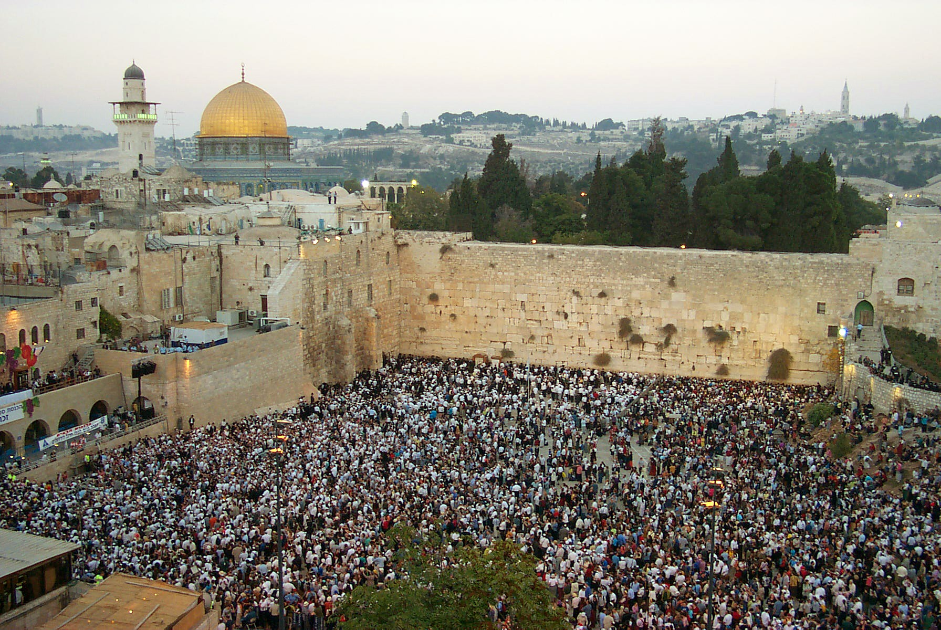
The most joyous time of the year

Slide 93
His Presence
God dwelling with his people – desert
Yeshua dwelling on earth – 1st coming
(born on Sukkot?)
God’s Holy Spirit dwelling within us
Yeshua’s return and reign – 2nd coming
reigning with Him in the Millennium

Slide 94
His Provision
He provided water & manna in the desert
He provided the annual harvest
(Also called Feast of the Ingathering)
He provided His Son to save us
He provided His Spirit to indwell us

Slide 95
Revelation 20:1-3
Then I saw an angel coming down from heaven, holding in his hand the key to the bottomless pit and a great chain. And he seized the dragon, that ancient serpent, who is the devil and Satan, and bound him for a thousand years, and threw him into the pit, and shut it and sealed it over him, so that he might not deceive the nations any longer, until the thousand years were ended. After that he must be released for a little while.

Slide 96
Revelation 20:4
Then I saw thrones, and seated on them were those to whom the authority to judge was committed. Also I saw the souls of those who had been beheaded for the testimony of Jesus and for the word of God, and those who had not worshiped the beast or its image and had not received its mark on their foreheads or their hands. They came to life and reigned with Christ for a thousand years.

Slide 97
Revelation 20:5-6
The rest of the dead did not come to life until the thousand years were ended. This is the first resurrection. Blessed and holy is the one who shares in the first resurrection! Over such the second death has no power, but they will be priests of God and of Christ, and they will reign with him for a thousand years.

Slide 98
Sukkot
The end of the final harvest
THANKSGIVING
God and his people sukkah’ing together
His PRESENCE & PROVISION
Journey to the Promised Land
Symbolizes Messiah’s reign as King
The Millennium – 1000 year reign
starting on this very same day??

Slide 99

3 Spring Appointed Times
Passover – Crucifixion
Unleavened Bread – Burial
Firstfruits – Resurrection
First
Harvest
Shavuot (Pentecost) – Holy Spirit
Wheat
Harvest
3 Fall Appointed Times
Trumpets – The 2nd Coming
Atonement – Judgment Day
Sukkot – Messiah’s reign as King
Final
Harvest

Slide 100
Why “seven days” of Sukkot?
And what about the 8th Day?

Slide 101
Leviticus 23:34-36
On the fifteenth day of this seventh month and for seven days is the Feast of Booths to YHWH. On the first day shall be a holy convocation; you shall not do any ordinary work. For seven days you shall present food offerings to YHWH. On the eighth day you shall hold a holy convocation and present a food offering to YHWH. It is a solemn assembly; you shall not do any ordinary work.

Slide 102

The 8th Day
the last and
greatest day of the feast

Slide 103

Why “seven days”?
And what about the 8th Day?
Seven symbolizes “completeness”
Journey to the promised land is over
The 8th day = a new beginning,
a new aspect of life,
a new era

Slide 104
Seven = a complete cycle
Seven days for creation
Seven days in a weekly cycle
Seven appointed times in a year
Seven weeks after Firstfruits to Shavuot
Seven years in sabbatical cycle
Seven sabbaticals (49 yrs) in jubilee cycle
Seven “1000-years” in this era
(according to Jewish tradition)

Slide 105
Seven days of creation
One day = 1000 years
Psalm 90:4
For a thousand years in your sight are but as yesterday when it is past, or as a watch in the night.
2 Peter 3:8
But do not overlook this one fact, beloved, that with the Lord one day is as a thousand years, and a thousand years as one day.

Slide 106
Seven days of creation
One day = 1000 years
Man was created on day 6
So 6 is the number of man
(666 – the mark of the beast)
The first 6000 years = reign of man
Day 7 = God set apart, made holy
The last 1000 years = reign of Messiah
Weekly Sabbath foreshadows this
Seven days of Sukkot foreshadows this
Revelation speaks of the Millennium

Slide 107
8th begins something totally new
Seven days in a weekly cycle
8th day starts a new weekly cycle
Yeshua resurrected on day after Sabbath
Early writings refer to this as the 8th Day
Seven weeks after Firstfruits to Shavuot
Next day (8th week, day 50) was Shavuot
Seven years in sabbatical cycle
8th year began new cycle (Lev 25:22)
Seven sabbaticals (49 yrs) in jubilee cycle
Next year (8th cycle, year 50) was jubilee

Slide 108
Eighth day – Offering of Firstborn
Seven days with its mother,
then on the 8th day it belongs to God
Exodus 22:30
The firstborn of your sons you shall give to me. You shall do the same with your oxen and with your sheep: seven days it shall be with
its mother; on the eighth day you shall
give it to me.

Slide 109
Eighth day - Circumcision
Dedication to God
8th day begins a new phase of life
Exodus 22:29-30
And on the eighth day the flesh of his foreskin shall be circumcised.

Slide 110
Seven days of Sukkot
& the 8th Day
Journey to the promised land
The 8th day = entering the promised land
Recalls the 7 days of creation
The 8th day = entering a new era
Foreshadows the millennium
The 8th day = a new heaven
and a new earth

Slide 111
Revelation 20:5-6
And when the thousand years are ended, Satan will be released from his prison and will come out to deceive the nations that are at the four corners of the earth, Gog and Magog, to gather them for battle; their number is like the sand of the sea. And they marched up over the broad plain of the earth and surrounded the camp of the saints and the beloved city, but fire came down from heaven and consumed them, and the devil who had deceived them was thrown into the lake of fire and sulfur where the beast and the false prophet were, and they will be tormented day and night forever and ever.

Slide 112
Revelation 21:1-4
Then I saw a new heaven and a new earth, for the first heaven and the first earth had passed away, and the sea was no more. And I saw the holy city, new Jerusalem, coming down out of heaven from God, prepared as a bride adorned for her husband. And I heard a loud voice from the throne saying, “Behold, the dwelling place of God is with man. He will dwell with them, and they will be his people, and God himself will be with them as their God.

Slide 113
Revelation 21:4-5
He will wipe away every tear from their eyes, and death shall be no more, neither shall there be mourning, nor crying, nor pain anymore, for the former things have passed away.” And he who was seated on the throne said, “Behold, I am making all things new.” Also he said, “Write this down, for these words are trustworthy and true.”

Slide 114
Living in the Promised Land, experiencing the fullness of
His Presence & His Provision
Revelation 21:6-7
And he said to me, “It is done! I am the Alpha and the Omega, the beginning and the end. To the thirsty I will give from the spring of the water of life without payment. The one who conquers will have this heritage, and I will be his God and he will be my son.

Slide 115
3 Spring Appointed Times
Passover – Crucifixion
Unleavened Bread – Burial
Firstfruits – Resurrection
First
Harvest
Shavuot (Pentecost) – Holy Spirit
Wheat
Harvest
3 Fall Appointed Times
Trumpets – The 2nd Coming
Atonement – Judgment Day
Sukkot – Millennial reign
+ 8th Day - New heaven & earth
Final
Harvest

Slide 116
God’s Appointed Times:
Not “Jewish Holidays”
All about the Messiah
The Days are Significant – Appointed!
Why wouldn’t we celebrate them?

Slide 117
Do you want to thrive in ministry?
In life??
Keep your Appointments with YHWH
you will be blessed!
Learn the Text, Live the Text, Die the Text
Our journey to intimacy with YHWH…

Slide 119
Sabbath

Slide 120
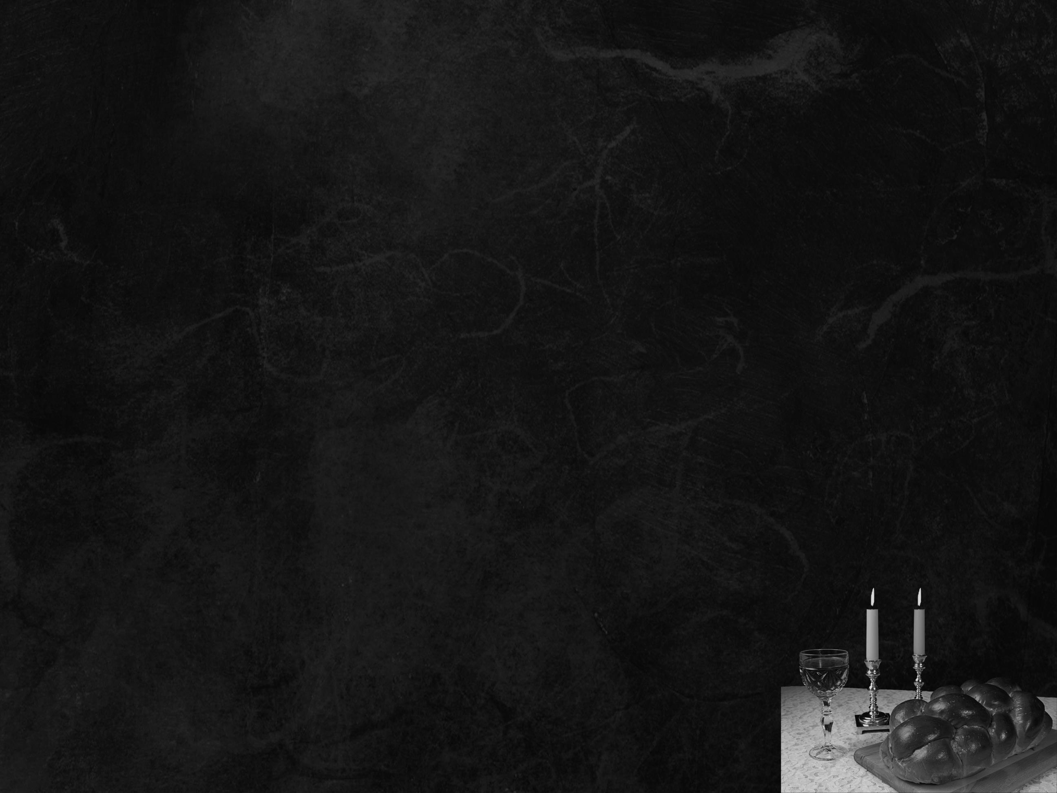
Leviticus 23:3
Six days shall work be done, but on the seventh day is a Sabbath of solemn rest, a holy convocation. You shall do no work. It is a Sabbath to YHWH in all your dwelling places.

Slide 121
Genesis 2:2-3
And on the seventh day God finished his work that he had done, and he rested on the seventh day from all his work that he had done. So God blessed the seventh day and made it holy.

Slide 122
The 4th Commandment at Sinai:
Exodus 20:8–10
Remember the Sabbath day, to keep it holy. Six days you shall labor, and do all your work, but the seventh day is a Sabbath to YHWH your God. On it you shall not do any work, you, or your son, or your daughter, your male servant, or your female servant, or your livestock, or the sojourner who is within your gates.

Slide 123
And what is the reason?
Exodus 20:11
For in six days YHWH made heaven and earth, the sea, and all that is in them, and rested on the seventh day. Therefore YHWH blessed the Sabbath day and made it holy.

Slide 124
And after the Torah is given:
Exodus 31:13–14
You are to speak to the people of Israel and say, “Above all you shall keep my Sabbaths, for this is a sign between me and you throughout your generations, that you may know that I, YHWH, sanctify you. You shall keep the Sabbath, because it is holy for you. Everyone who profanes it shall be put to death. Whoever does
any work on it, that soul shall be
cut off from among his people.”

Slide 125
Exodus 31:15–16
Six days shall work be done, but the seventh day is a Sabbath of solemn rest, holy to YHWH. Whoever does any work on the Sabbath day shall be put to death. Therefore the people of Israel shall keep the Sabbath, observing the Sabbath throughout their generations, as a covenant forever.

Slide 126
For Gentiles too:
Isaiah 56:6–7
And the foreigners who join themselves to YHWH, to minister to him, to love the name of YHWH, and to be his servants, everyone who keeps the Sabbath and does not profane it, and holds fast my covenant -- these I will bring to my holy mountain, and make them joyful in my house of prayer; their burnt offerings and their sacrifices will be accepted on my altar; for my house shall be called a house of prayer for all peoples.

Slide 127
The Sabbath is our Blessing:
Isaiah 58:13–14
If you turn back your foot from the Sabbath, from doing your pleasure on my holy day, and call the Sabbath a delight and the holy day of YHWH honorable; if you honor it, not going your own ways, or seeking your own pleasure, or talking idly; then you shall take delight in YHWH, and I will make you
ride on the heights of the earth.

Slide 128
A sign that we are set apart:
Ezekiel 20:12
Moreover, I gave them my Sabbaths, as a sign between me and them, that they might know that I am YHWH who sanctifies them.

Slide 129
An Appointed Time of YHWH
The Sabbath is a Picture
Recalls PAST event
Has PRESENT application
Foreshadows a FUTURE fulfillment

Slide 130
Seven days of creation
One day = 1000 years
Man was created on day 6
So 6 is the number of man
(666 – the mark of the beast)
The first 6000 years = reign of man
Day 7 = God set apart, made holy
The last 1000 years = reign of Messiah
Weekly Sabbath foreshadows this
Revelation:
Messiah reigns 1000 years

Slide 131
The Sabbath Rest of Hebrews 4
Hebrews 4:9–10
So then, there remains a Sabbath rest for the people of God, for whoever has entered God’s rest has also rested from his works as God did from his.
Entering the promised land = REST
The Sabbath = REST
With Messiah = REST
ALL foreshadows the Millennium

Slide 132
The Seventh Day
Sabbath is the 7th day of the week &
Sukkot is the 7th Appointed Time
Sukkot & Sabbath picture the millennium
King Messiah dwells with His people
Satan is bound and we rest in Messiah
The Bridegroom & the bride
begin married life together

Slide 133
Do you want to thrive in ministry?
In life??
Keep the Sabbath -
you will be blessed!
Keep the Appointed Times -
you will be even more blessed!
Learn the Text, Live the Text, Die the Text
Our journey to intimacy with YHWH

