Slide 1
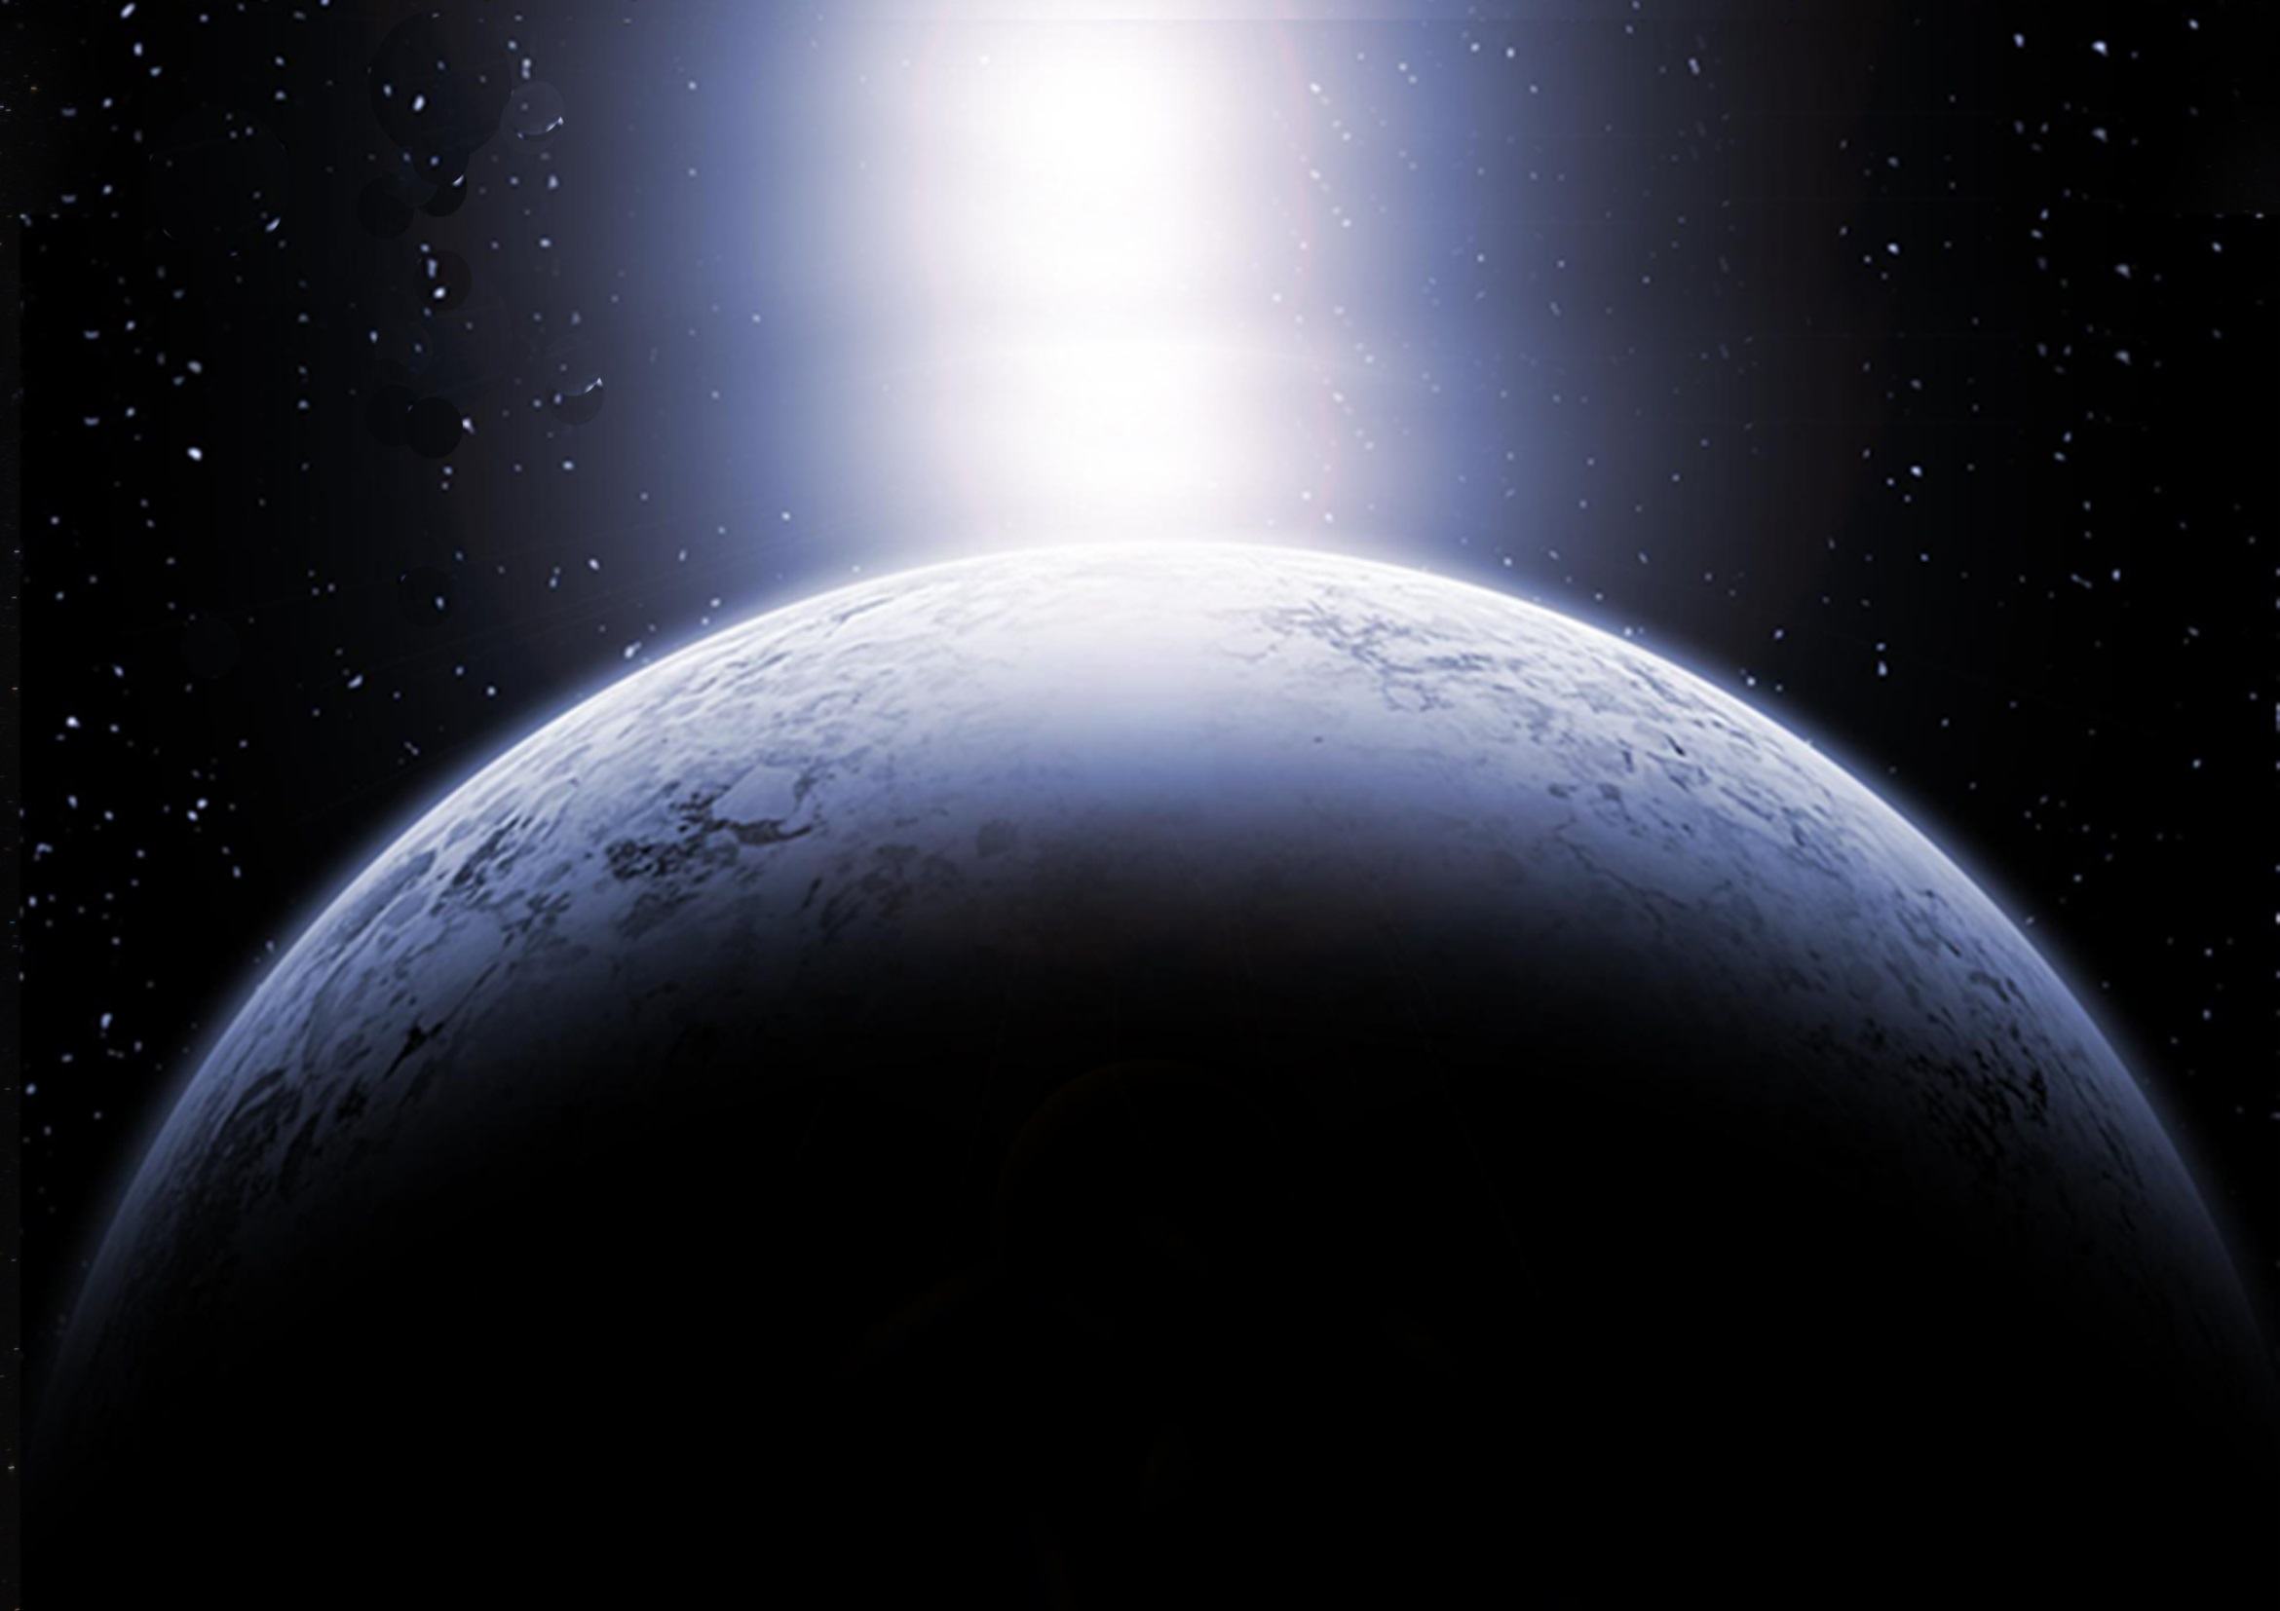

Slide 2
Sukkot
and The End Times
The Ultimate Fulfillment of God’s PRESENCE & God’s PROVISION

Slide 3
The end of Sukkot
The end of the harvest
The end of the journey
The end of the age
The end of a great week
What happens next?

Slide 4
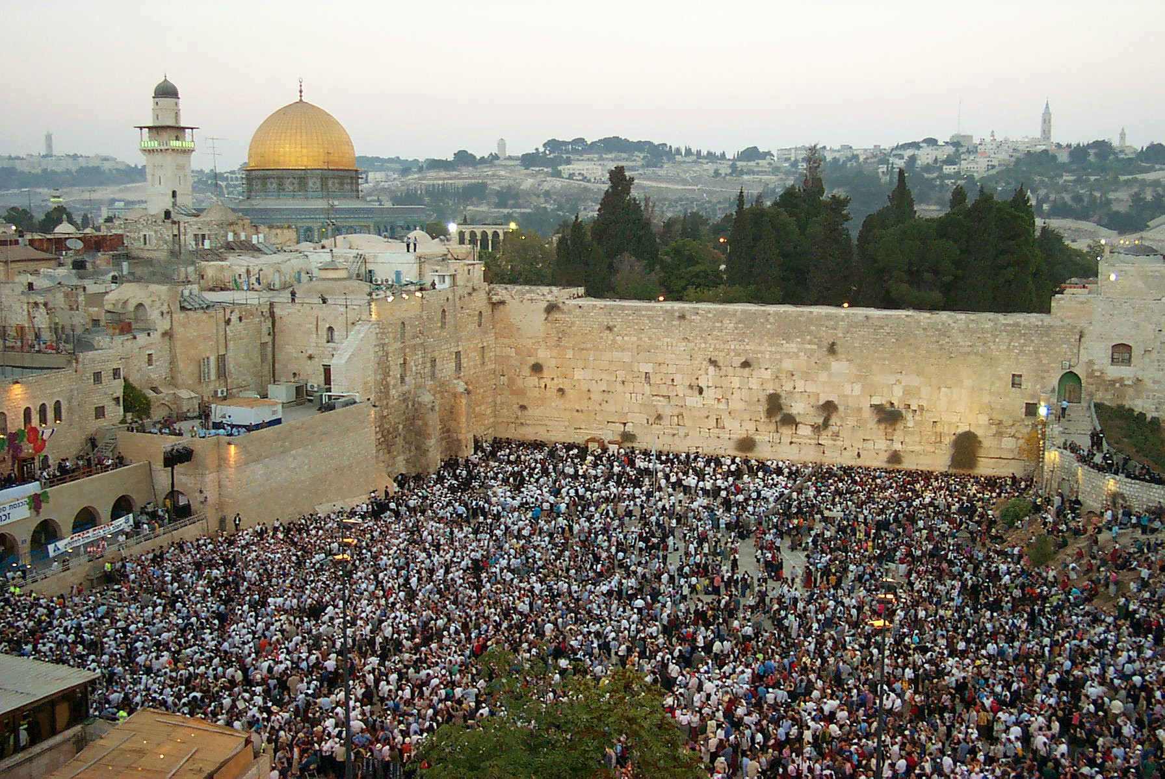
The most joyous time of the year

Slide 5
8th Day
the last and greatest day of the feast

Slide 6
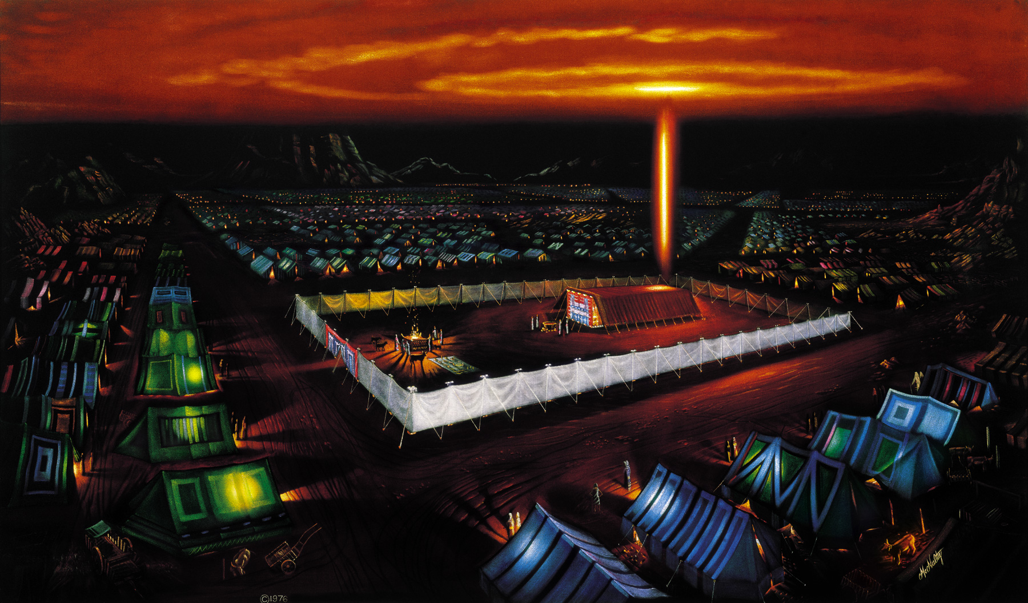
Journey to the Promised Land

Slide 7
Seven Annual Appointed Times of YHWH
Recall PAST events
Have PRESENT applications
Foreshadow FUTURE fulfillments

Slide 8
3 Spring Appointed Times
Passover – Crucifixion
Unleavened Bread – Burial
Firstfruits – Resurrection
First Harvest
Shavuot (Pentecost) – Holy Spirit
Wheat Harvest
3 Fall Appointed Times
Trumpets – Messiah’s Return
Atonement – Judgment Day
Sukkot – Messiah’s reign as King
Final Harvest

Slide 9
Day of Trumpets
Gathering people for Appointed Time
Gathering people for battle
For the crowning of a king
For the anointing of a High Priest
For the arrival of the bridegroom
Looks forward to Yeshua’s return

Slide 10
Matthew 24:29-31
Immediately after the tribulation of those days the sun will be darkened, and the moon will not give its light, and the stars will fall from heaven, and the powers of the heavens will be shaken. Then will appear in heaven the sign of the Son of Man, and then all the tribes of the earth will mourn, and they will see the Son of Man coming on the clouds of heaven with power and great glory. And he will send out his angels with a loud trumpet call, and they will gather his elect from the four winds, from one end of heaven to the other.

Slide 11
I Corinthians 15:51-52
Behold! I tell you a mystery. We shall not all sleep, but we shall all be changed, in a moment, in the twinkling of an eye, at the last trumpet. For the trumpet will sound, and the dead will be raised imperishable, and we shall be changed.

Slide 12
Revelation 11:15-17
Then the seventh angel blew his trumpet, and there were loud voices in heaven, saying, “The kingdom of the world has become the kingdom of our Lord and of his Christ, and he shall reign forever and ever.” And the twenty-four elders who sit on their thrones before God fell on their faces and worshiped God, saying, “We give thanks to you, Lord God Almighty, who is and who was, for you have taken your great power and begun to reign.

Slide 13
Day of Atonement
Recalls High Priest going into the Holy of Holies to stand in God’s presence
The High Priest would either live or die in God’s presence
Symbolizes Judgment Day, when everyone will stand before God to either live or die in His presence

Slide 14
Revelation 11:18-19
The nations raged, but your wrath came, and the time for the dead to be judged, and for rewarding your servants, the prophets and saints, and those who fear your name, both small and great, and for destroying the destroyers of the earth. Then God’s temple in heaven was opened, and the ark of his covenant was seen within his temple. There were flashes of lightning, rumblings, peals of thunder, an earthquake, and heavy hail.

Slide 15
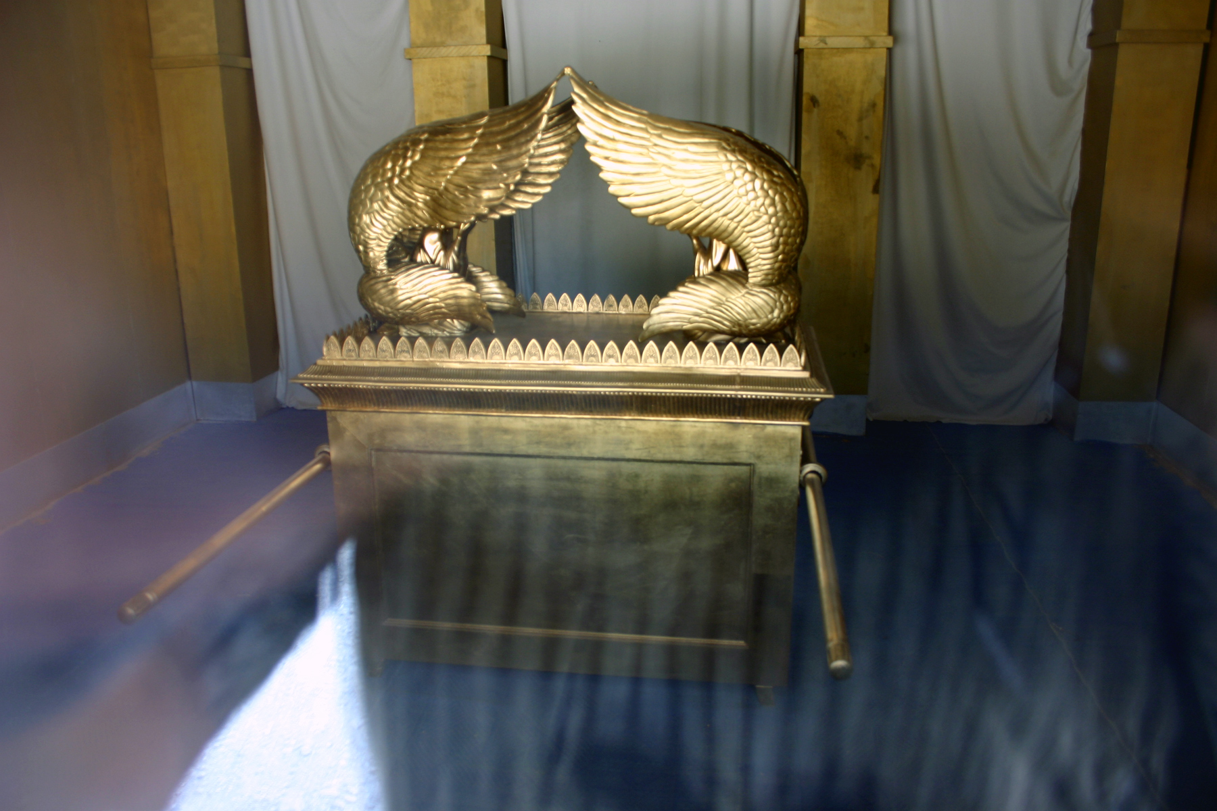

Slide 16
Revelation 14:7 And he said with a loud voice, “Fear God and give him glory, because the hour of his judgment has come, and worship him who made heaven and earth, the sea and the springs of water.”

Slide 17
Revelation 14:14-16 Then I looked, and behold, a white cloud, and seated on the cloud one like a son of man, with a golden crown on his head, and a sharp sickle in his hand. And another angel came out of the temple, calling with a loud voice to him who sat on the cloud, “Put in your sickle, and reap, for the hour to reap has come, for the harvest of the earth is fully ripe.” So he who sat on the cloud swung his sickle across the earth, and the earth was reaped.

Slide 18
Revelation 14:18-19 And another angel came out from the altar, the angel who has authority over the fire, and he called with a loud voice to the one who had the sharp sickle, “Put in your sickle and gather the clusters from the vine of the earth, for its grapes are ripe.” So the angel swung his sickle across the earth and gathered the grape harvest of the earth and threw it into the great winepress of the wrath of God.

Slide 19
The Final Harvest
The day of God’s wrath
A day to rejoice
A day to fear
What comes after the final harvest?
Sukkot !

Slide 20
3 Spring Appointed Times
Passover – Crucifixion
Unleavened Bread – Burial
Firstfruits – Resurrection
First Harvest
Shavuot (Pentecost) – Holy Spirit
Wheat Harvest
3 Fall Appointed Times
Trumpets – The 2nd Coming
Atonement – Judgment Day
Sukkot – Messiah’s reign as King
Final Harvest

Slide 21
Revelation 20:1-3 Then I saw an angel coming down from heaven, holding in his hand the key to the bottomless pit and a great chain. And he seized the dragon, that ancient serpent, who is the devil and Satan, and bound him for a thousand years, and threw him into the pit, and shut it and sealed it over him, so that he might not deceive the nations any longer, until the thousand years were ended. After that he must be released for a little while.

Slide 22
Revelation 20:4 Then I saw thrones, and seated on them were those to whom the authority to judge was committed. Also I saw the souls of those who had been beheaded for the testimony of Jesus and for the word of God, and those who had not worshiped the beast or its image and had not received its mark on their foreheads or their hands. They came to life and reigned with Christ for a thousand years.

Slide 23
Revelation 20:5-6 The rest of the dead did not come to life until the thousand years were ended. This is the first resurrection. Blessed and holy is the one who shares in the first resurrection! Over such the second death has no power, but they will be priests of God and of Christ, and they will reign with him for a thousand years.

Slide 24
Sukkot
The end of the final harvest THANKSGIVING
The journey to the promised land
God and his people sukkah’ing together His PRESENCE & His PROVISION
Foreshadows Messiah’s 1000 year reign

Slide 25
Why “seven days”? And what about the 8th Day?

Slide 26
Leviticus 23:34-36 On the fifteenth day of this seventh month and for seven days is the Feast of Booths to YHWH. On the first day shall be a holy convocation; you shall not do any ordinary work. For seven days you shall present food offerings to YHWH. On the eighth day you shall hold a holy convocation and present a food offering to YHWH. It is a solemn assembly; you shall not do any ordinary work.

Slide 27
Why “seven days”? And what about the 8th Day?
Seven symbolizes “completeness”
Journey to the promised land is over
The 8th day = a new beginning, a new aspect of life, a new era

Slide 28
Seven = a complete cycle
Seven days for creation
Seven days in a weekly cycle
Seven appointed times in a year
Seven weeks after Firstfruits to Shavuot
Seven years in sabbatical cycle
Seven sabbaticals (49 yrs) in jubilee cycle
Seven “1000-years” in this era (according to Jewish tradition)

Slide 29
Seven days of creation
One day = 1000 years
Psalm 90:4 For a thousand years in your sight are but as yesterday when it is past, or as a watch in the night.
2 Peter 3:8 But do not overlook this one fact, beloved, that with the Lord one day is as a thousand years, and a thousand years as one day.

Slide 30
Seven days of creation
One day = 1000 years
Man was created on day 6
So 6 is the number of man (666 – the mark of the beast)
The first 6000 years = reign of man
Day 7 = God set apart, made holy
The last 1000 years = reign of Messiah
Weekly Sabbath foreshadows this
Seven days of Sukkot foreshadows this
Revelation: Messiah reigns 1000 years

Slide 31
8th begins something totally new
Seven days in a weekly cycle 8th day starts a new weekly cycle
Yeshua resurrected on day after Sabbath Early writings refer to this as the 8th Day
Seven weeks after Firstfruits to Shavuot Next day (8th week, day 50) was Shavuot
Seven years in sabbatical cycle 8th year began new cycle (Lev 25:22)
Seven sabbaticals (49 yrs) in jubilee cycle Next year (8th cycle, year 50) was jubilee

Slide 32
Eighth day – Offering of Firstborn
Seven days with its mother, then on the 8th day it belongs to God
Exodus 22:30 The firstborn of your sons you shall give to me. You shall do the same with your oxen and with your sheep: seven days it shall be with its mother; on the eighth day you shall give it to me.

Slide 33
Eighth day - Circumcision
Dedication to God
8th day begins a new phase of life
Exodus 22:29-30 And on the eighth day the flesh of his foreskin shall be circumcised.

Slide 34
Seven days of Sukkot & the 8th Day
Journey to the promised land
The 8th day = entering the promised land
Recalls the 7 days of creation
The 8th day = entering a new era
Foreshadows the millennium
The 8th day = a new heaven & new earth

Slide 35
Revelation 20:5-6 And when the thousand years are ended, Satan will be released from his prison and will come out to deceive the nations that are at the four corners of the earth, Gog and Magog, to gather them for battle; their number is like the sand of the sea. And they marched up over the broad plain of the earth and surrounded the camp of the saints and the beloved city, but fire came down from heaven and consumed them, and the devil who had deceived them was thrown into the lake of fire and sulfur where the beast and the false prophet were, and they will be tormented day and night forever and ever.

Slide 36
Revelation 21:1-4 Then I saw a new heaven and a new earth, for the first heaven and the first earth had passed away, and the sea was no more. And I saw the holy city, new Jerusalem, coming down out of heaven from God, prepared as a bride adorned for her husband. And I heard a loud voice from the throne saying, “Behold, the dwelling place of God is with man. He will dwell with them, and they will be his people, and God himself will be with them as their God.

Slide 37
Revelation 21:4-5 He will wipe away every tear from their eyes, and death shall be no more, neither shall there be mourning, nor crying, nor pain anymore, for the former things have passed away.” And he who was seated on the throne said, “Behold, I am making all things new.” Also he said, “Write this down, for these words are trustworthy and true.”

Slide 38
Living in the Promised Land, experiencing the fullness of His Presence & His Provision
Revelation 21:6-7 And he said to me, “It is done! I am the Alpha and the Omega, the beginning and the end. To the thirsty I will give from the spring of the water of life without payment. The one who conquers will have this heritage, and I will be his God and he will be my son.

Slide 39
Sukkot
8th Day
Living in the Promised Land
Living in the Presence of YHWH and the Messiah
in the New Heaven & the New Earth

Slide 40
Journey to the “Promised Land”
PAST - Journey from Egypt to the land of Canaan
FUTURE - Journey from creation to the new heaven & the new earth
PRESENT - Our personal journey from life without God to life with Him at the center

Slide 41
The 8th Day of Sukkot
Marks the end of the journey
Marks the beginning of a new life
What happens next for YOU?

Slide 42
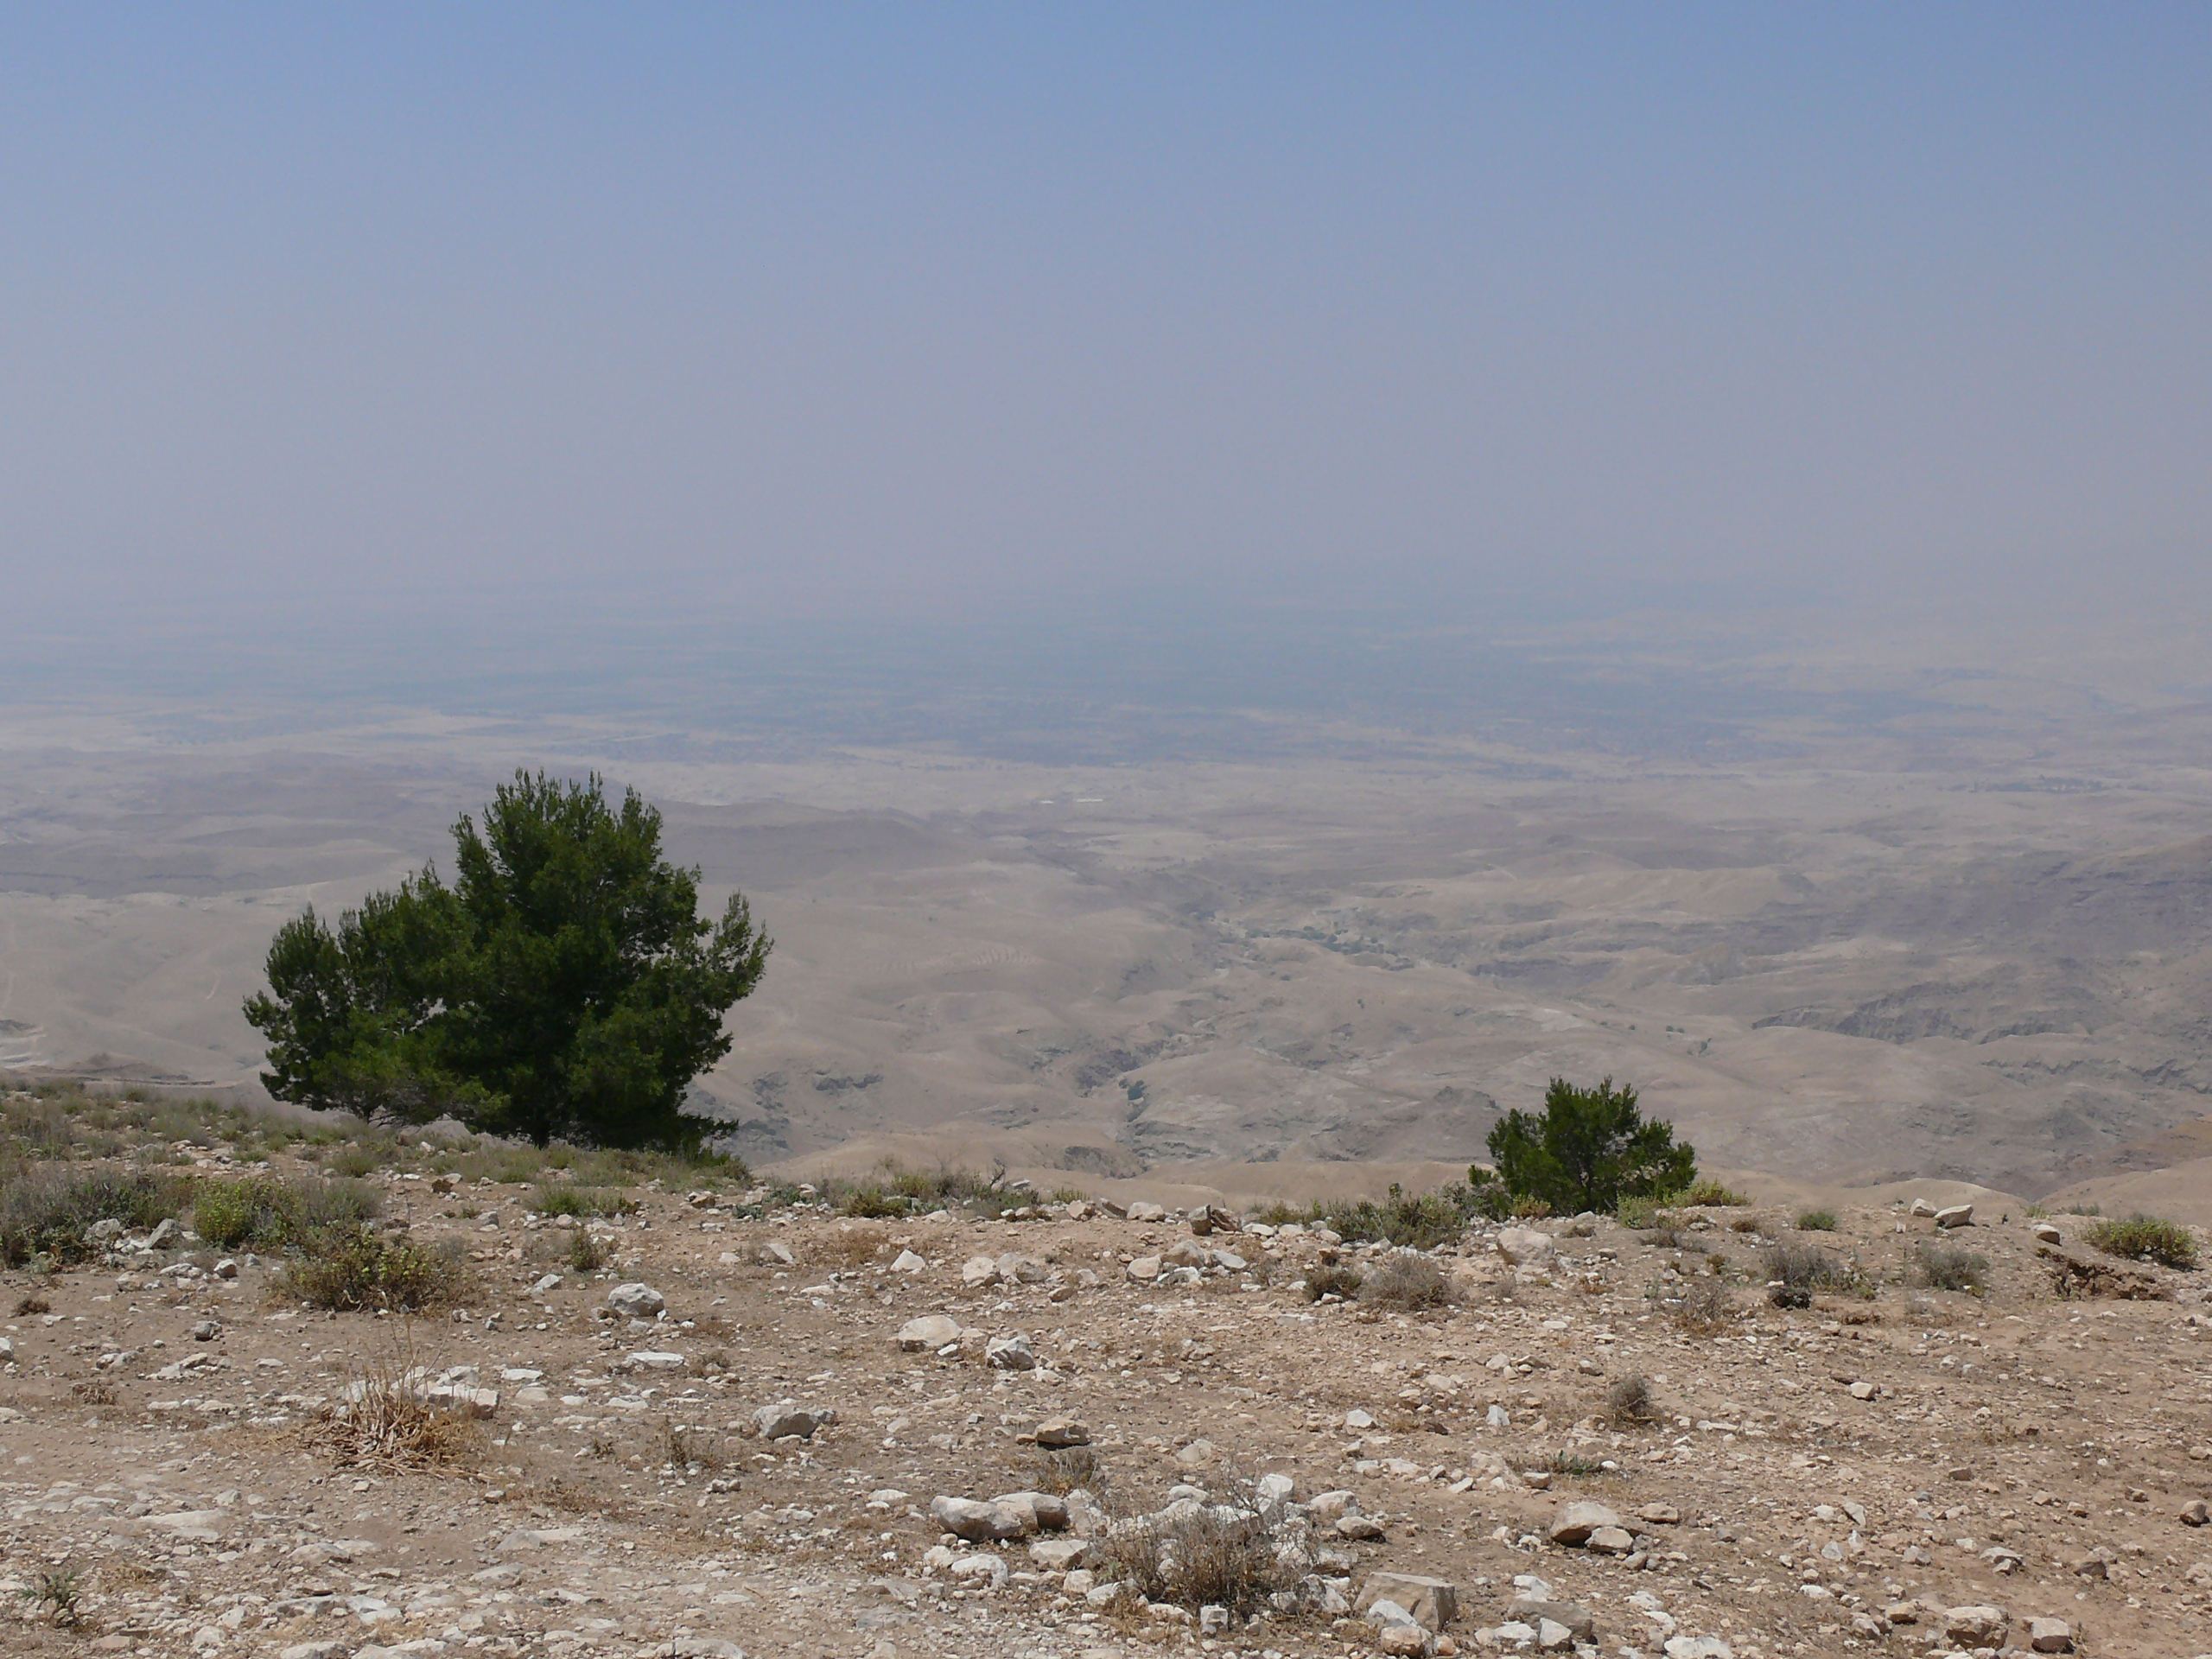
Entering the Promised Land

Slide 43
Deuteronomy 29:1,9 These are the words of the covenant that YHWH commanded Moses to make with the people of Israel in the land of Moab, besides the covenant that he had made with them at Horeb... Therefore keep the words of this covenant and do them, that you may prosper in all that you do.

Slide 44
Deuteronomy 27:1-3 Now Moses and the elders of Israel commanded the people, saying, “Keep the whole commandment that I command you today. And on the day you cross over the Jordan to the land that YHWH your God is giving you, you shall set up large stones and plaster them with plaster. And you shall write on them all the words of this law, when you cross over to enter the land that YHWH your God is giving you, a land flowing with milk and honey, as YHWH, the God of your fathers, has promised you.

Slide 45
As you begin the 8th Day
Renew your covenant with YHWH
Commit to not making the same mistakes
Commit to “keep the whole commandment”
Commit to reading his Word, and doing it
Biblical “new year’s resolution”
Record your commitment - in your Bible, in a journal, on a stone...

Slide 46
Sukkot
OUR Journey to the “Promised Land”
Experiencing God’s Presence & Provision Past, Present, and Future

Slide 48
Save This

